Slide 1
Azure Logic Apps
March 28, 2019 — 8:30 AM - 5:00 PM | Detroit, Michigan
Learn, architect, and develop solutions on Azure
#AzureDevDays
for developers, by developers
Learn.
Connect.
Explore.

Slide 2
Overview

Slide 3

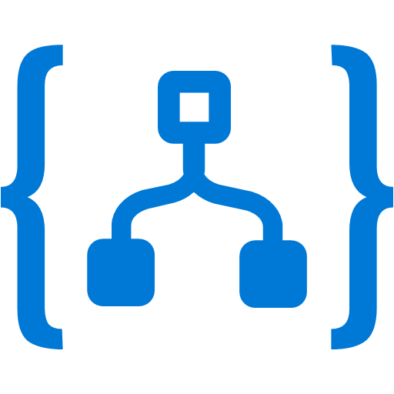
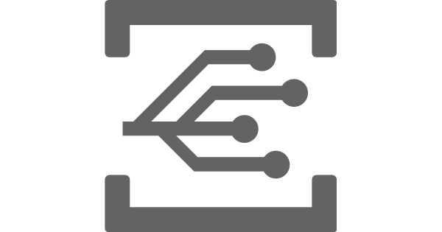
Serverless in Azure
Functions
Logic Apps
Event Grid
Serverless compute
Serverless workflow
Serverless events
Notes:
3 primary services in Azure for serverless.

Slide 4
Logic App capabilities
Visual workflow designer
Workflows are a series of conditions and actions*
170+ Connectors
to apps and data
*Actions an include Functions
Notes:
With logic apps you can create workflows consisting of a trigger and a series of actions using no-code and a visual designer.
Actions in your workflows can connect to various services to read and write data.
Workflows can contain both pre-built actions, custom Azure Functions or even nested logic app workflows.

Slide 5
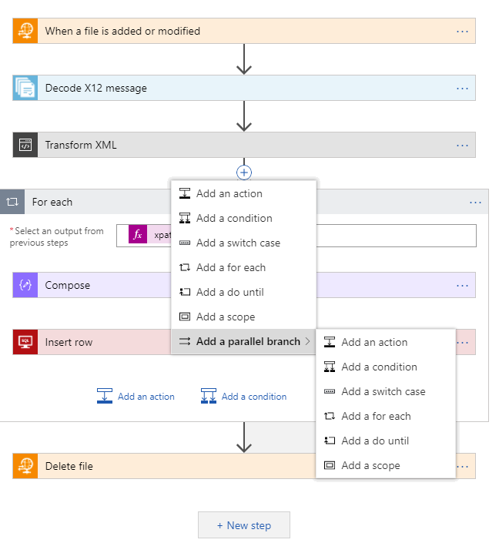
Azure Logic Apps
Fast integration using innovative Visual Designer
Easy workflow creation with triggers and actions
More than 200+ connectors to mashup applications, data and services
Built for mission critical 24x7 Enterprise Integration
Devops built-in: Create, deploy, manage and monitor
Notes:
Azure Logic Apps Powerful Capabilities

Slide 6


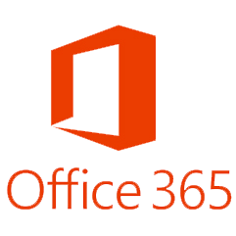



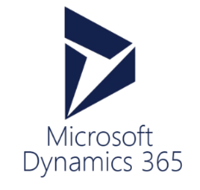
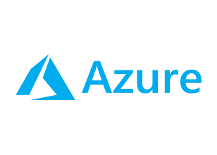
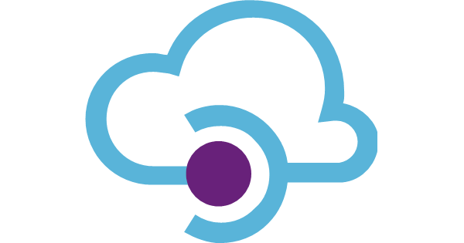
Connected with over 200 connectors
Cloud APIs and platform functionality
Over 200 out of box connectors
SaaS, on-prem, protocols, B2B and message manipulation
Hybrid connectivity
Hosted and managed within the platform
Scales to meet your needs
First class designer experience
API connections
Authenticate once and reuse
Differentiate connection configuration
Simple to deploy
Portal experience for managing API Connections
Custom Connectors
Access any REST/SOAP API
Cloud or on-premises
Simple creation wizard
Connections and managed secrets
First class designer experience

Slide 7
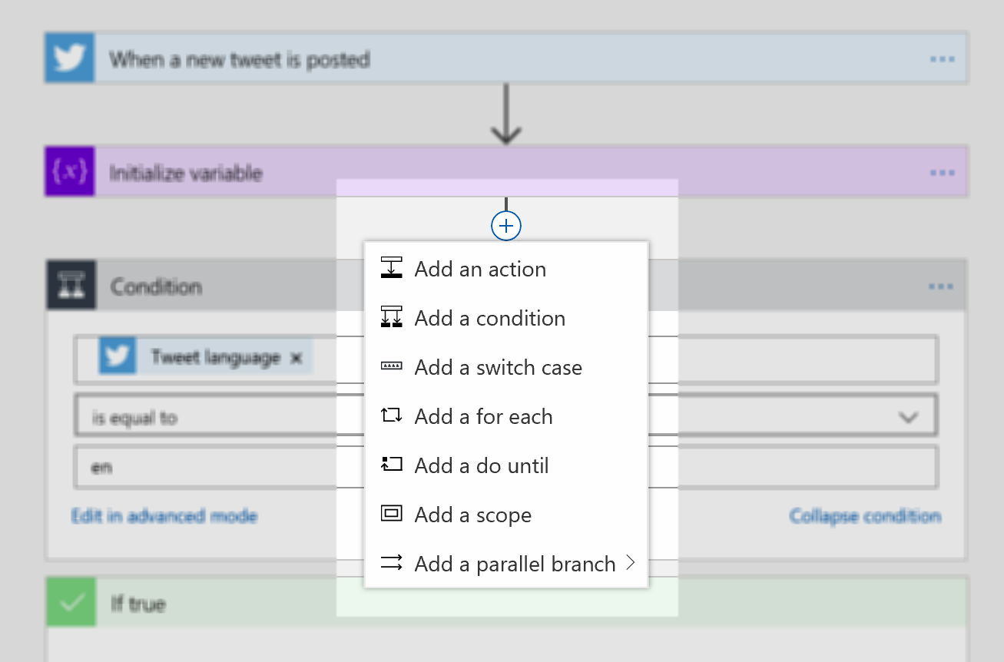
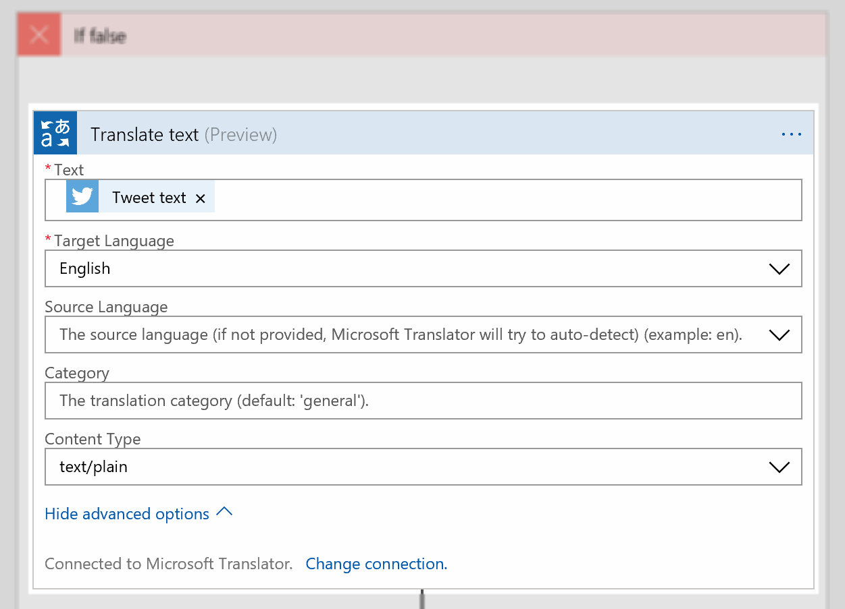
Visual designer
Add triggers, actions, conditions and loops visually
Configure properties with no coding needed
Notes:
Here is an example of a logic app in the visual designer:
The app is started by a recurrence trigger that kicks it off on a recurring schedule, for example every 30 minutes.
Then it gets travel time using an action that connects to Bing maps.
Next it stores the travel time in a variable for use in future actions.
The next step is a condition to see whether the travel time exceeds a certain amount.
If it does the Outlook action sends a notification email.

Slide 8
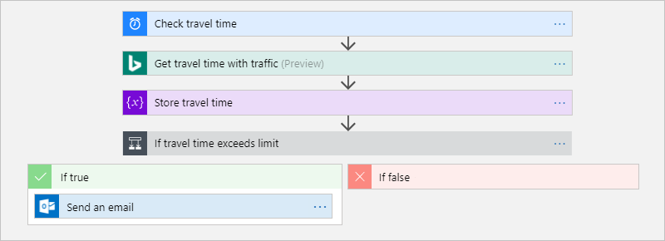
Example logic app in the visual designer
Notes:
<Transition to next slide>

Slide 9
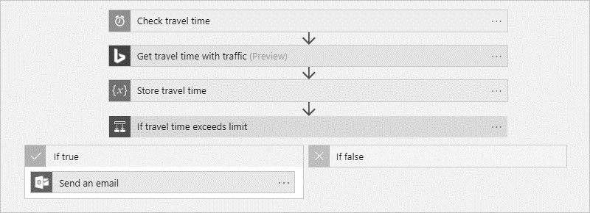
Example logic app in the visual designer
Trigger
Action
Action
Condition
Action
Notes:
Here is an example of a logic app in the visual designer:
The app is started by a recurrence trigger that kicks it of on a recurring schedule, for example every 30 minutes.
Then it gets travel time using an action that connects to Bing maps.
Next it stores the travel time in a variable for use in future actions.
The next step is a condition to see whether the travel time exceeds a certain amount.
If it does the outlook action sends a notification email.

Slide 10

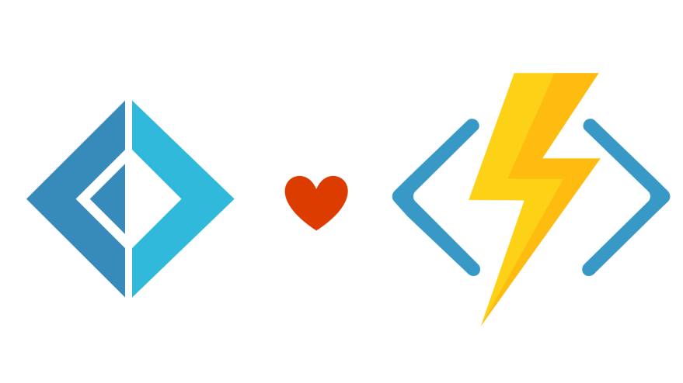

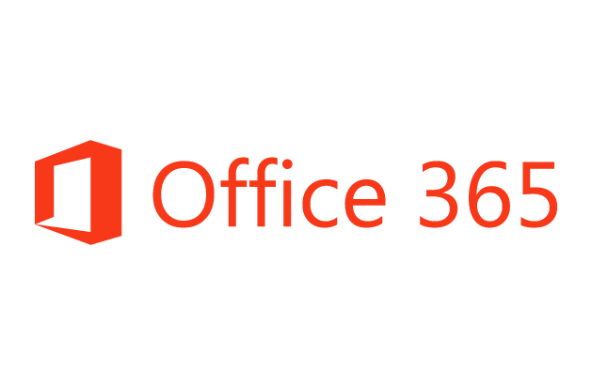
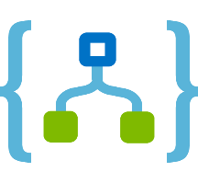
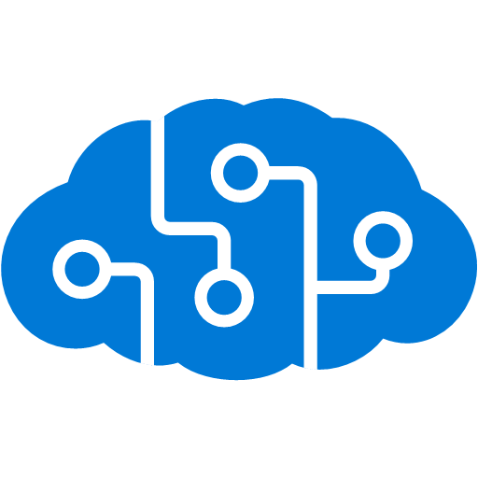
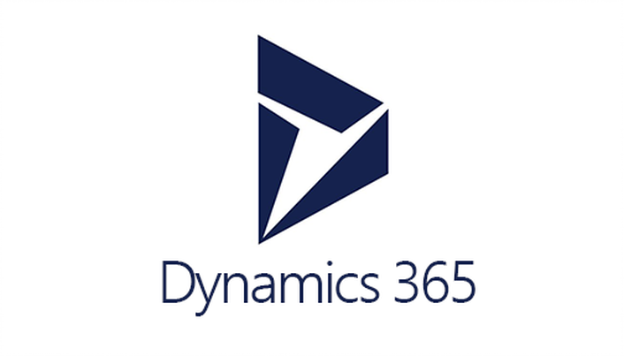


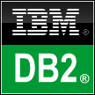



Logic Apps connect everything (200+ connectors)
Azure Functions
Service bus
Cognitive services
Logic Apps
Machine learning
On-premises data gateway
BizTalk server
Notes:
Some actions like the “Get travel time” action in the previous app needs to connect to a service (Bing maps in this case) to retrieve data.
Logic Apps allow you to connect to hundreds of cloud services including consumer services like Twitter and business apps like Office 365 or Salesforce.
Logic Apps can also be connected to on premises systems like SAP and SharePoint or databases like SQL Server and Oracle.

Slide 11
Flow Control

Slide 12
Triggers
Schedule
HTTP Request
Azure Queue
Via Connectors
SharePoint
Email Received
FTP
OneDrive
JIRA
BOX
SAP
SalesForce
Twitter
Adobe

Slide 13
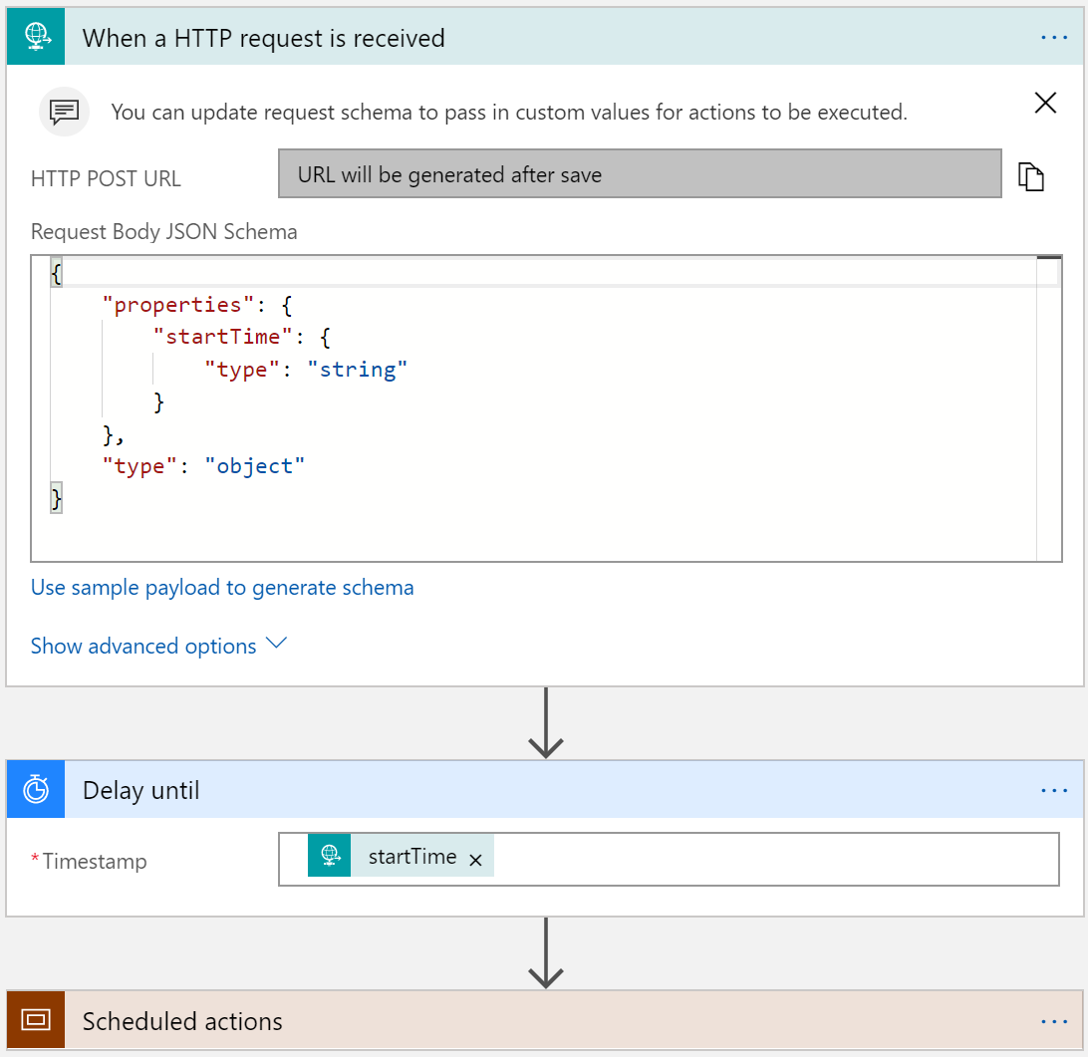
Scheduling executions
Example workloads
Cleanup jobs, data synchronization, running reports, data compression
Simple Recurrence
Every 5 minutes, every 2 days
Recurrence with deterministic time
Use start time
Every hour on the hour, every day at midnight
Complex schedules
Every Sunday at noon, every 15 minutes during work hours
Run once jobs
Request trigger + Start time input
Delay Until (start time)

Slide 14
Flow control
Until Condition is met
Do-until loop
Evaluated condition, total time, or count
When a Timeout has occurred
Configure timeout action setting
While other work is being done
Parallel actions
Notes:
Logic apps provide a highly parallel execution environment.

Slide 15
Concurrency Control
Runs
Instances are created concurrently
Singleton trigger executions
Parallel actions
Implicit parallelization
Join with Run After
For Each Loops
Collections handled concurrently
Sequential For Each
Degrees of parallel execution
Only for non split-on polling triggers
For each degrees of parallelism
Do Until Loops
Runs sequentially
Notes:
Runs:
Each trigger will start another Logic App instance by default.
There is a setting that will make only one instance of your logic app run at a time.
This is useful for integration with less capable downstream systems.
For each loops:
Run in parallel by default (20 parallel items at a time)
There is a setting to run your loop in serial
Do until loops:
Runs sequentially by default.

Slide 16
Workflow composition and re-use
Transport agnostic
Trigger workflow handles transport, formats the request and calls common workflow
Process broker
Broker workflow determines child workflows that should be called
Loosely coupled stages: Process forwarding for long running workflows
Notes:
Transport agnostic – e.g. xml coming on frp server, json format coming on a queue or via http connector
Process broker – one logic app that calls other logic apps or Azure functions
Long running process controller – once a workflow is started, it will finish execution using the work flow definition at the start. If it’s important to reflect newer, later deployed versions, then separate your long running workflow into stages each of which is a separate workflow

Slide 17
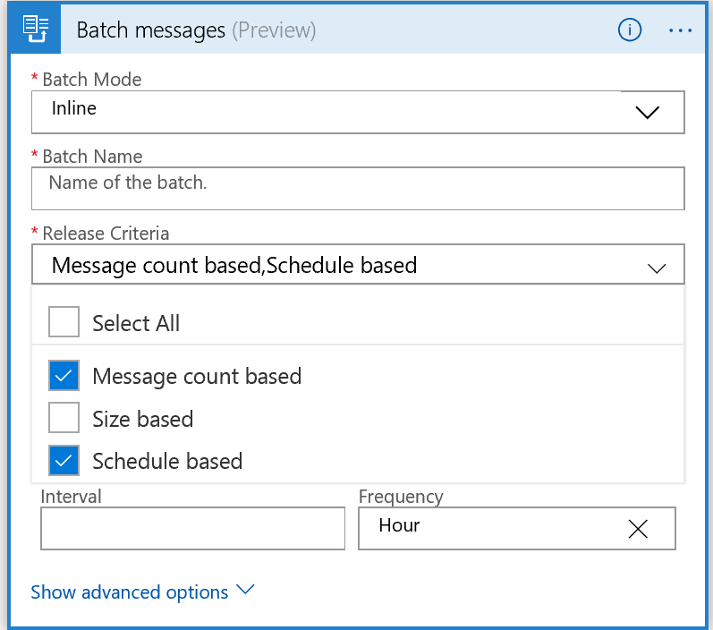
Messaging Patterns
Request/Reply (sync and async)
Splitter
Pub-Sub
Claim-Check
Batch
Sender and receiver logic apps: 1 or more senders and 1 receiver that uses the new Batch trigger
Batch release criteria: count, time, size
Notes:
Request/Reply: if you have a request end point, you may have a reply at the end of your workflow (synchronous), but you may also have it earlier in the process acknowledging receiving the request and continuing with asynchronous processing
Splitter – on trigger, can have a SplitOn property. Used if your workflow receives a collection or batch of items to process. You can choose a property that is used to create a new instance of the workflow to parallelize the work with multiple workflow instances processing the request, i.e. spliton property.
Pub-Sub – using Event Grid or Service Bus
Claim-check – If you want to pass big workloads around, put that data into a blob and use a reference to it (URI) as data in your message. e.g. service bus has a limit on message size.
Batch – grouping desperate messages for processing. This is very useful in cases where it’s important not to overwhelm a downstream system by numerous individual requests
Note: batch release criteria can be composed, e.g. process whatever we have every hour regardless of number of messages, or every 100 messages…

Slide 18
Error Handling

Slide 19
Error Handling
https://docs.microsoft.com/en-us/azure/logic-apps/logic-apps-exception-handling
Retry policy
Default, Exponential Interval, Fixed Interval, and disabled
Run After
Conditional dependency control
Status: Succeeded, Failed, TimedOut, Skipped
Terminate
Early termination
Failed or Successful status
Scopes
Encapsulate a set of actions
Status: Determined by the status of the leaf nodes within the Scope
Succeeded: all must have succeeded
Skipped: all must have been skipped
Failed: any not succeeded or skipped
Notes:
Retry policy = If and how the request should be retried when it fails.
Default, none, fixed interval and exponential interval
Run after = When you need to create dependencies between actions.
Terminate = Stop the workflow due to a condition or failure.
Scopes = Group a set of actions together with a status (e.g. try, catch, finally).

Slide 20
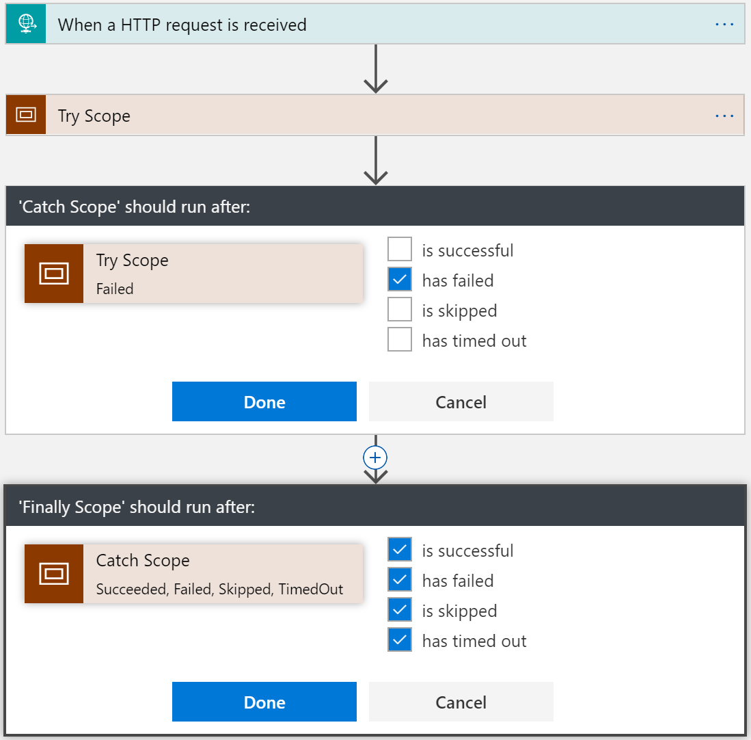
try { . . . } catch { . . . } finally { . . . }
Notes:
Try
Put actions in a Try scope
Catch
Run after Try scope Failed
Finally
Run after Catch scope Succeeded, Skipped, TimedOut, or Failed

Slide 21
Security

Slide 22
Secure access to your logic apps
https://docs.microsoft.com/en-us/azure/logic-apps/logic-apps-securing-a-logic-app
Constrains on who can initiate the workflow
API Management
HTTP or WebHook triggered workflows
Firewall
Shared access keys (part of URL) - https://docs.microsoft.com/en-us/azure/storage/common/storage-dotnet-shared-access-signature-part-1
Notes:
Shared access keys or use API Management to expose an endpoint to ip ranges and via Azure AD authentication.

Slide 23
Secure access to resources
Credentials used in connectors
Individual vs. shared accounts
http://mikaelsand.se/securing-passwords-in-logic-apps/ and https://docs.microsoft.com/en-us/azure/azure-resource-manager/resource-manager-keyvault-parameter
Shared between workflows in same resource group
Notes:
Today use a “secure string” property to keep secrets for your logic app.
Azure Key Vault integration is on the product group’s backlog for H2FY18.
Connections defined affect all logic apps in the resource group.

Slide 24
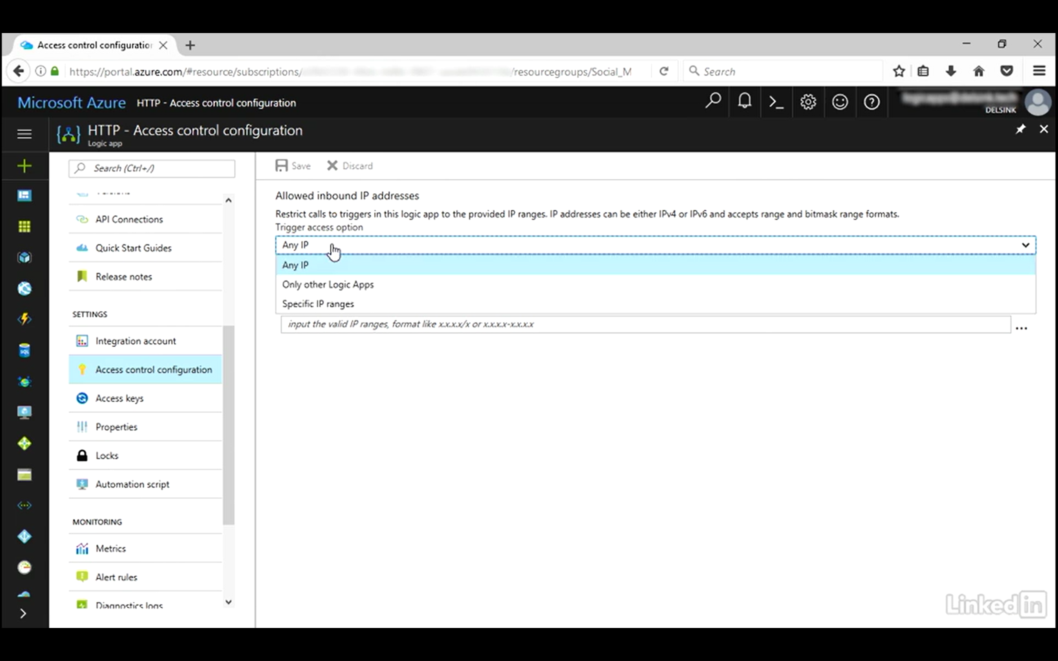

Slide 25
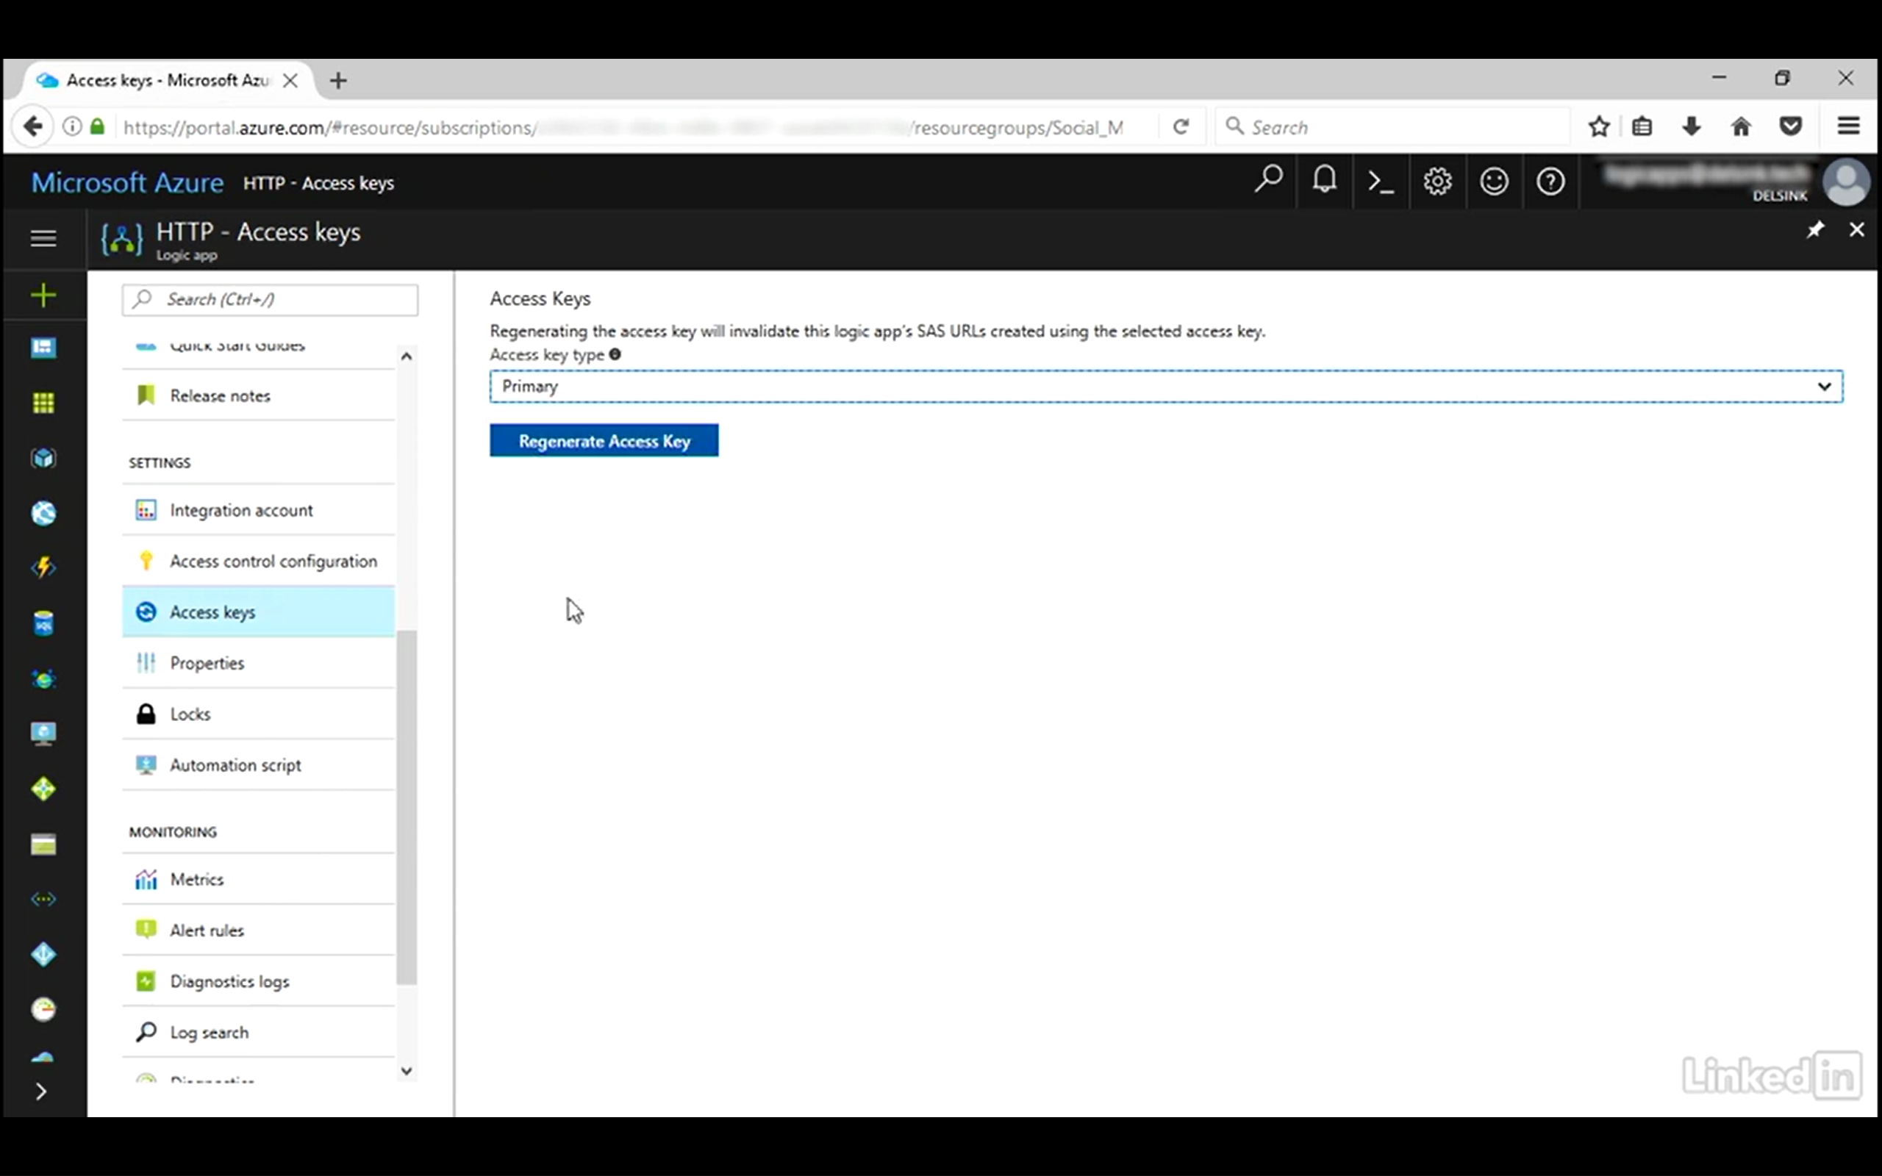

Slide 26
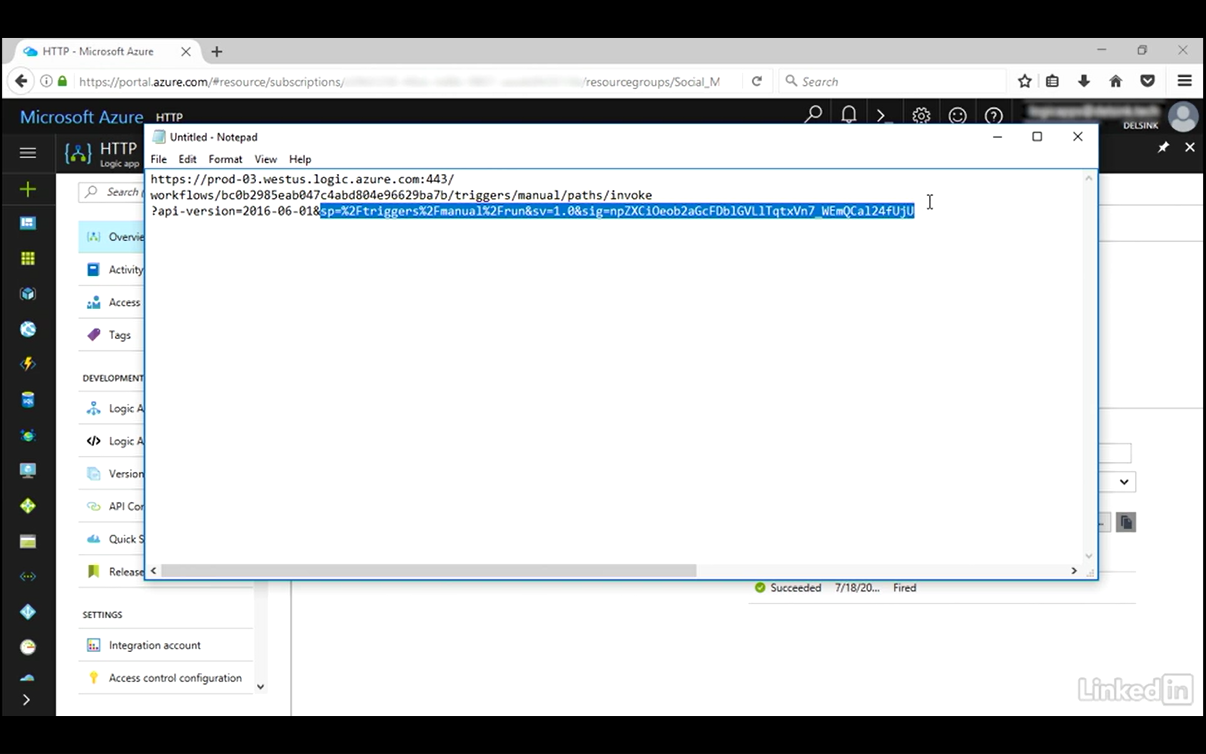
Notes:
Regenerating the key, changes the URL of your workflow endpoint

Slide 27
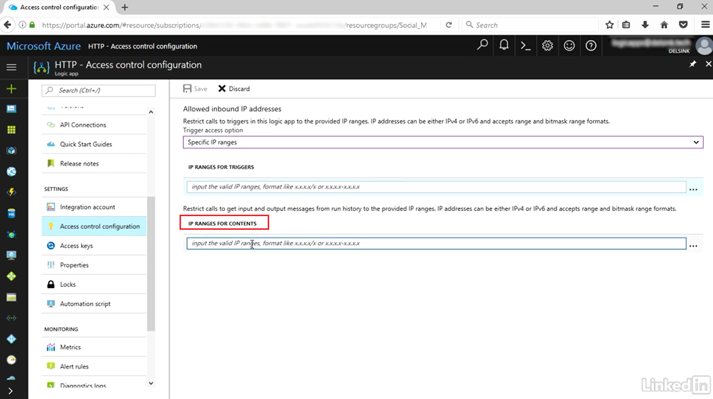
Secure operational access
RBAC Roles: Logic App Contributor and Logic App Operator
Azure Resource Lock
Restrict access to Run History and diagnostic logs
Notes:
Assign Azure AD accounts to roles for administering Logic Apps.

Slide 28
Monitoring

Slide 29
Monitoring and Diagnostics
Trigger and run history
Runtime details – monitoring view
Diagnostic logging and Alerts
Tracked properties
Tracking API
Operations Management Suite
https://docs.microsoft.com/en-us/azure/logic-apps/logic-apps-monitor-your-logic-apps

Slide 30
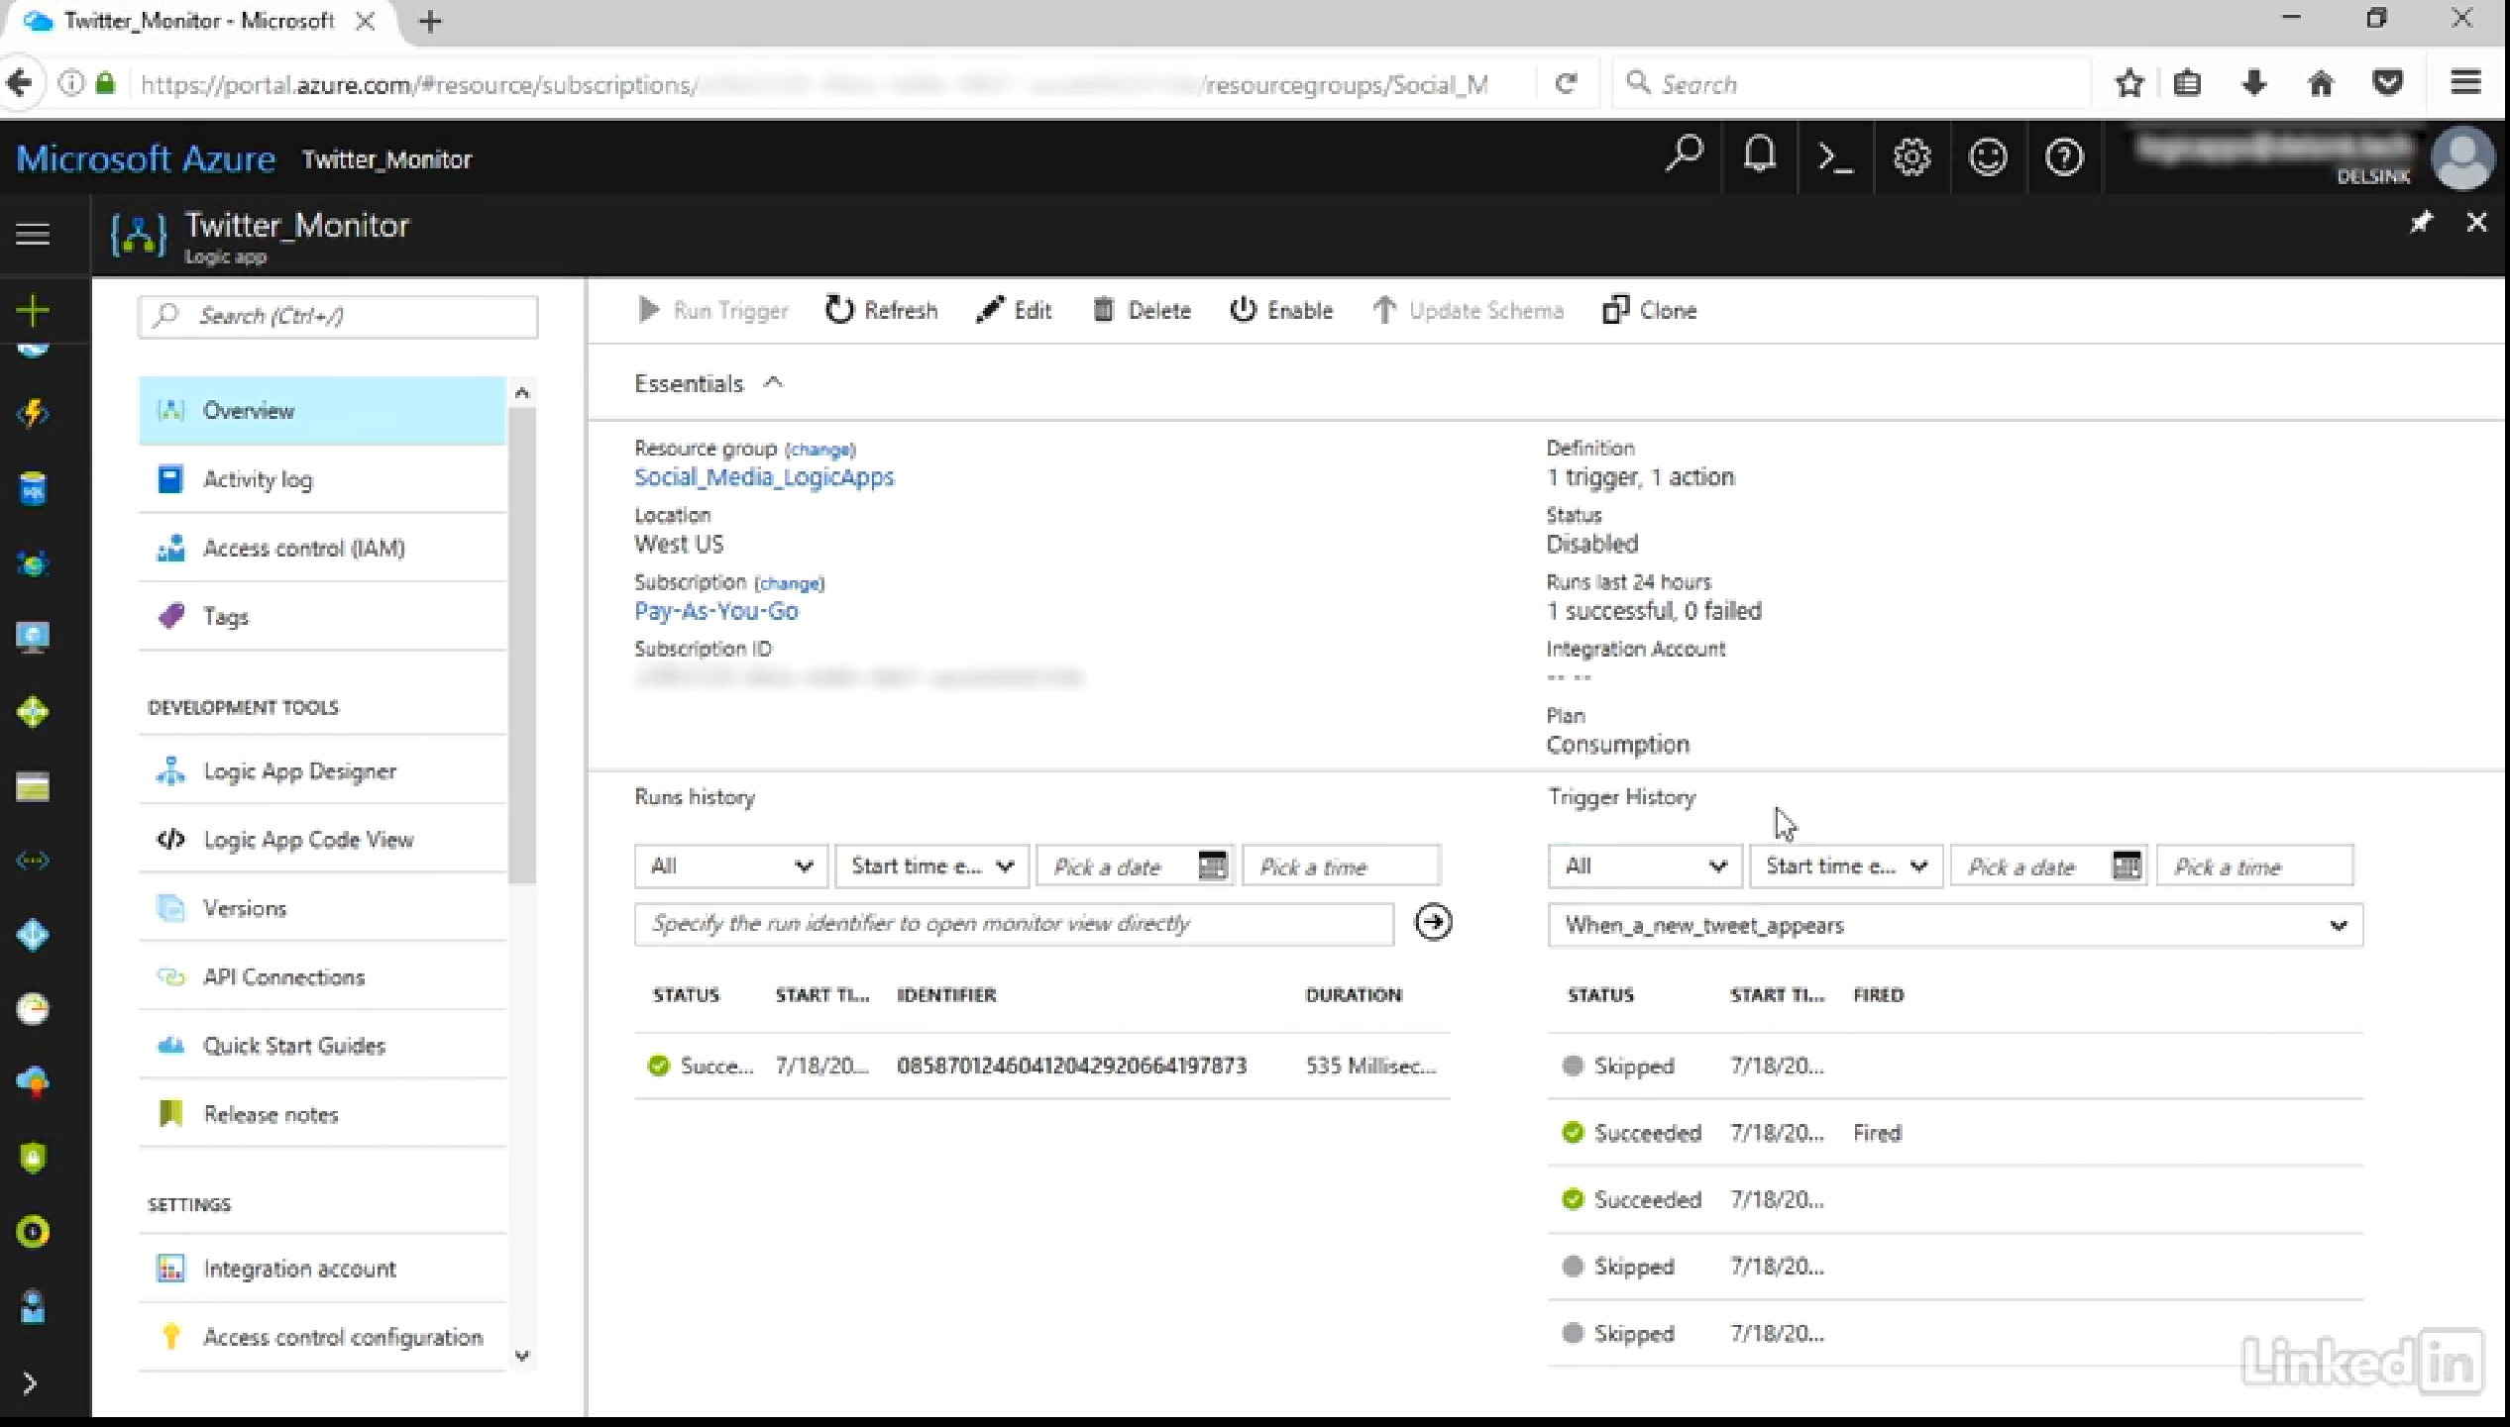
Trigger and run history

Slide 31
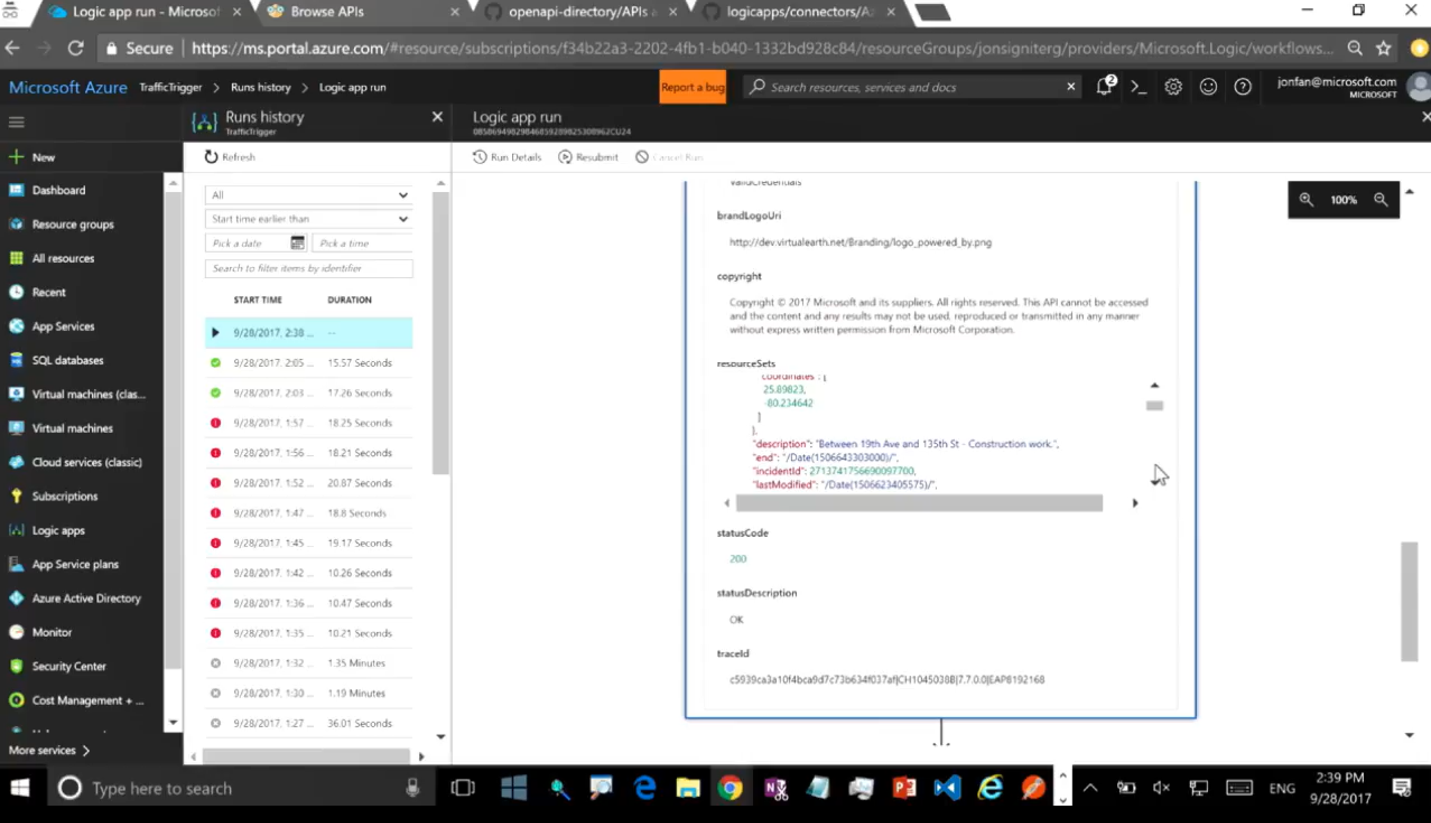
Runtime details – monitoring view
Notes:
Can see the details of what happened at every step:
Inputs
Outputs

Slide 32
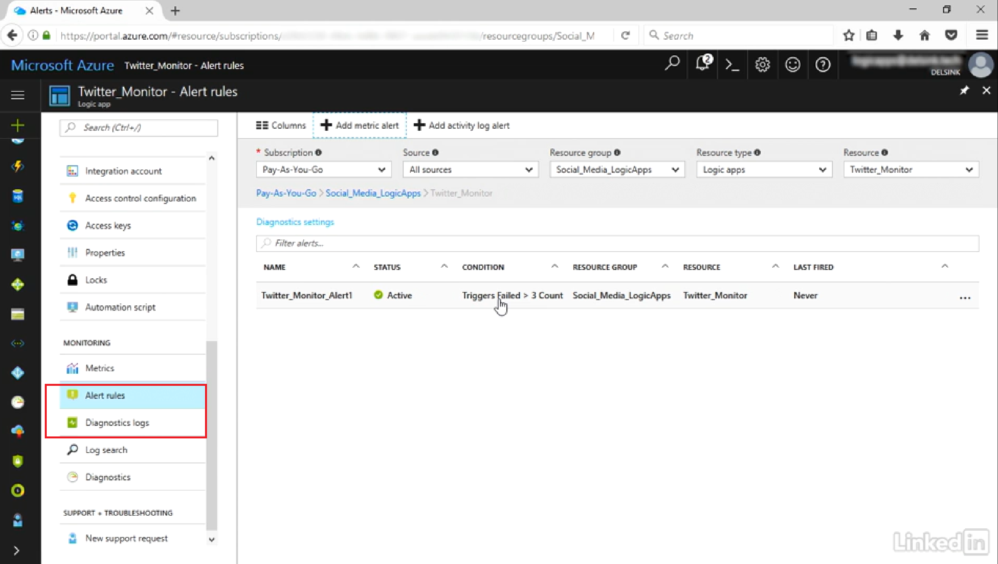
Diagnostic Logging and Alerts
Notes:
Can enable diagnostic logging to be sent to storage, event hub or OMS (Operations Management Suite)…

Slide 33
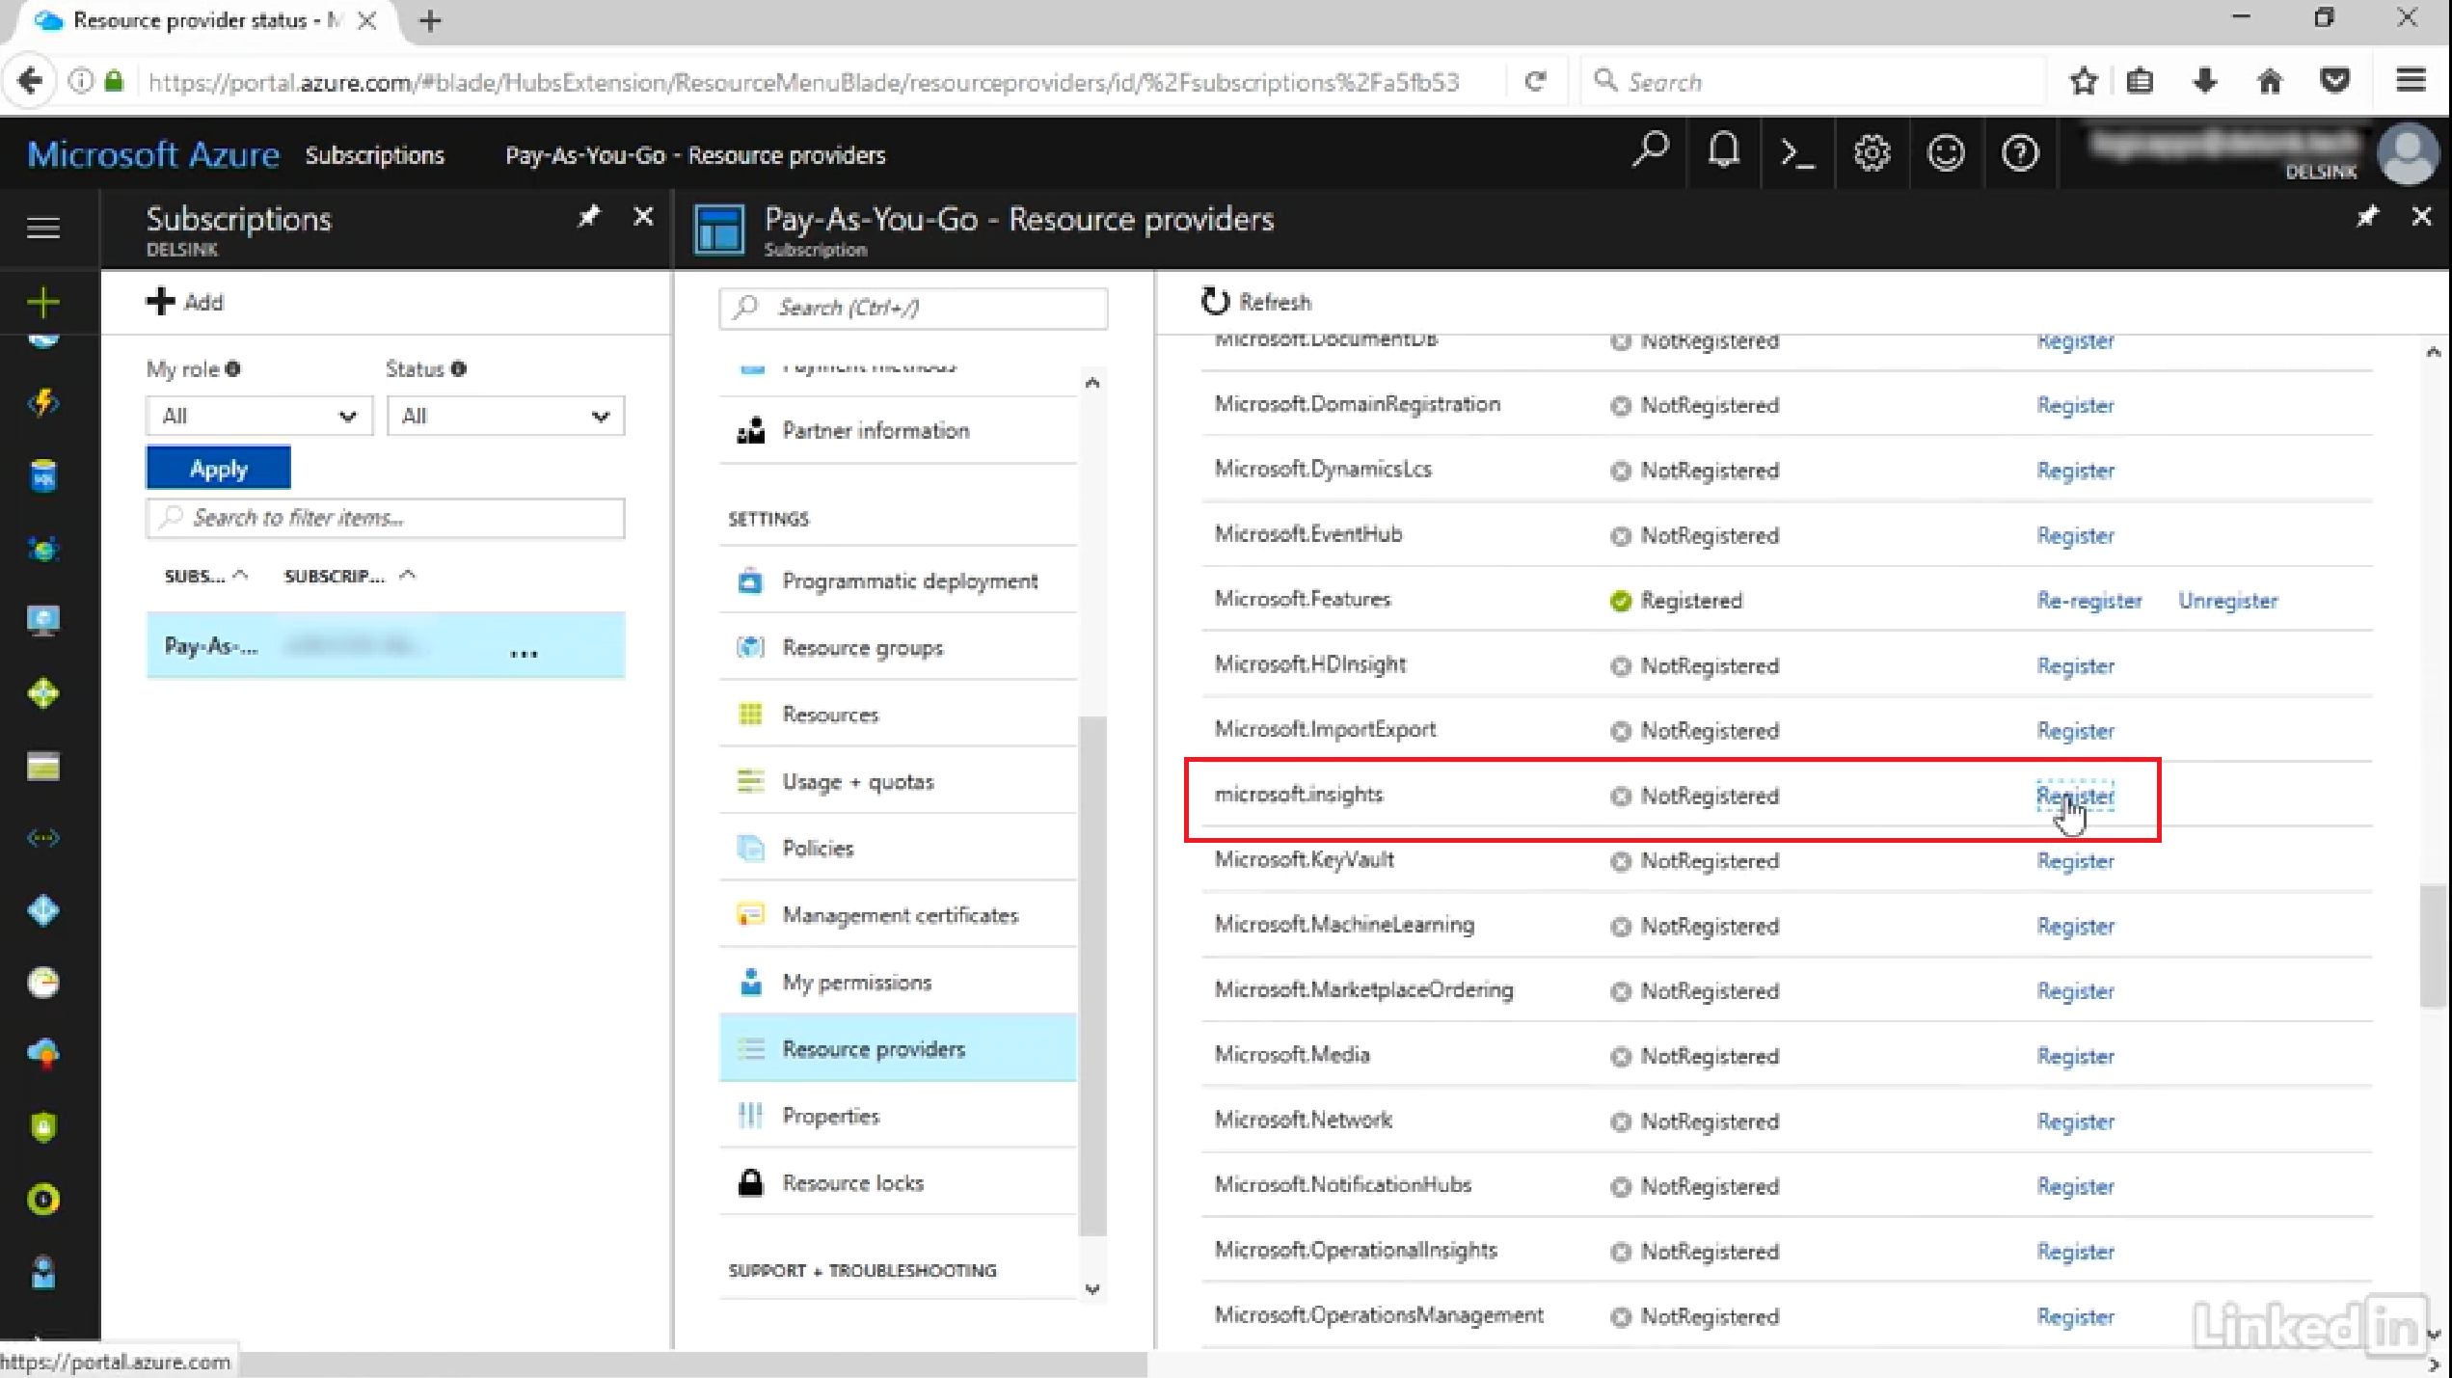
Notes:
Microsoft Insights resource provider must be registered in order for Diagnostics feature to be available.

Slide 34
Service Description

Slide 35
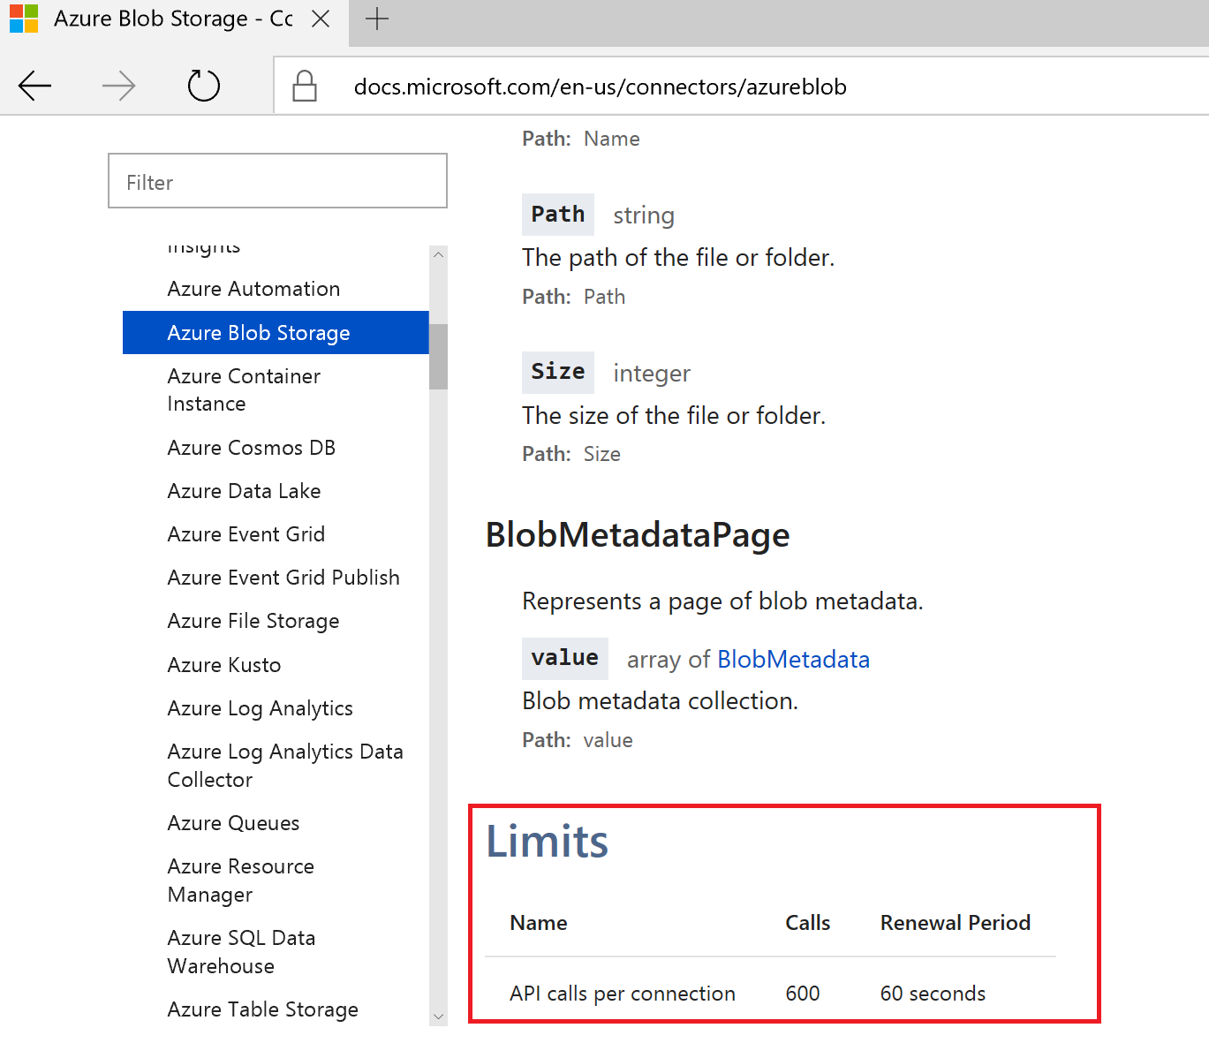
Limits and Config Know your connector invocation limits
https://docs.microsoft.com/en-us/azure/logic-apps/logic-apps-limits-and-config
.
Notes:
Azure event grid – 100 calls per connection per min
File storage – 600 calls per connection per min
Kusto – 100 calls per connection per min
. . .
Each subscription has limits on number of concurrent connections

Slide 36
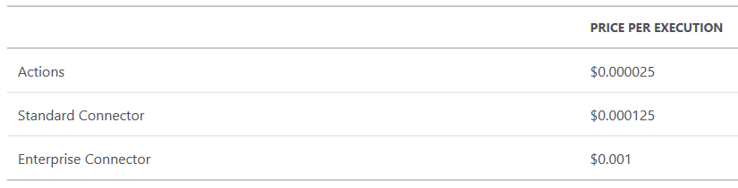
Usage Costs
Per execution pricing
(Actions, Standard Connectors, Enterprise Connectors)
+
Per hour pricing
(Standard or Basic integration accounts – see resource limits)
+
Per GB per hour pricing
(data retention, e.g. diagnostic logs)
https://docs.microsoft.com/en-us/azure/logic-apps/logic-apps-pricing
https://azure.microsoft.com/en-us/pricing/details/logic-apps/
https://azure.microsoft.com/en-us/pricing/calculator/?service=logic-apps
Notes:
Every step in a logic app is an execution.
Every request to the endpoint is an execution.

Slide 37
Demo

Slide 38
Wrap

Slide 39
Logic apps benefits
Serverless – no server sizing/capacity planning, auto-scaling based on demand, high availability (no need to plan anything for fault tolerance), use-based billing (charge for consumption of resources only)
Drag and drop experience (no extensive coding experience required)
Lots of pre-built connectors (200+ and counting)
Receiving an e-mail, monitoring a twitter feed, sending a text message, ServiceBus, Hybrid connectors, IBM MQ, SAP, B2B support e.g. or AS2, X12, EDIFACT, etc.
Connectors are just API apps, so, if one is not available, you can create your own
300+ actions
Flow-control (If-then, switch, for-each, do-until, scope)
BizTalk 2016 has Logic App adapter for connecting to logic apps
OOB monitoring and logging

Slide 40
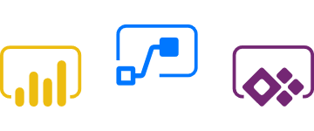


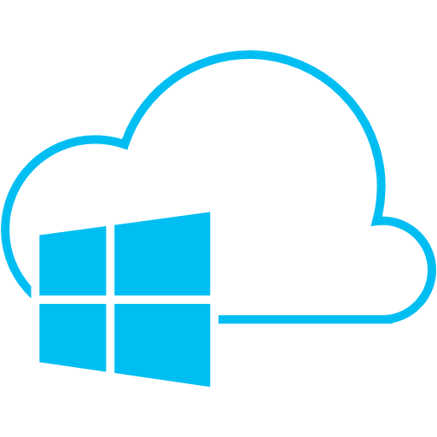
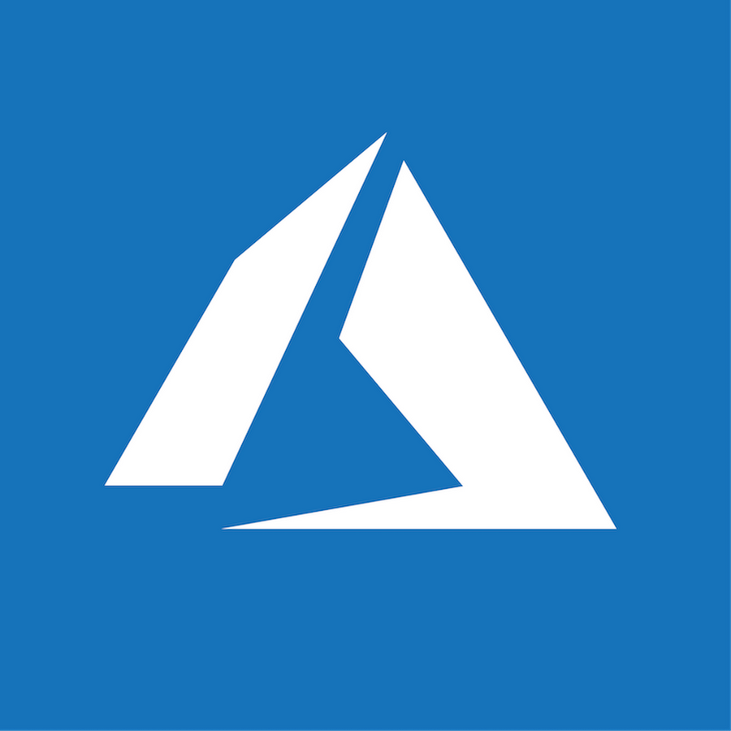
Microsoft Enterprise Integration Platform
Microsoft Flow
Enable the Citizen Developer to Do More
API Management
Document and catalog LOB APIs Discover, manage and secure connectivity Gain insights, measure and monetize
Logic Apps
Connect SaaS applications Serverless compute, auto scaling, fully managed Leverage Azure Services
BizTalk Server
Automate mission critical processes Integrate on-premises LOB to SaaS apps Support for latest Microsoft Platforms
Service Bus
Cloud-based messaging service Connect to the cloud Secure and predictable message delivery
Azure
Management Portal, Azure Resource Manager

Slide 41
When to use what
https://docs.microsoft.com/en-us/azure/azure-functions/functions-compare-logic-apps-ms-flow-webjobs
https://toonvanhoutte.wordpress.com/2017/09/12/azure-functions-vs-azure-logic-apps/
http://www.alliedc.com/logic-apps-vs-azure-functions-comparison/
https://social.msdn.microsoft.com/Forums/en-US/de98495a-9395-4468-933c-92bedf7d80da/logic-apps-vs-biztalk-server?forum=biztalkgeneral

Slide 42


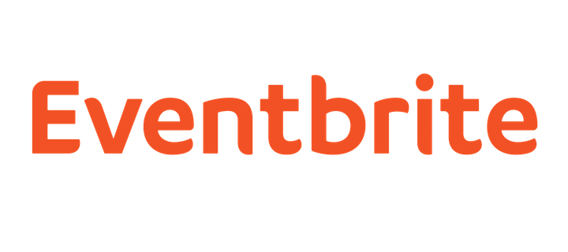





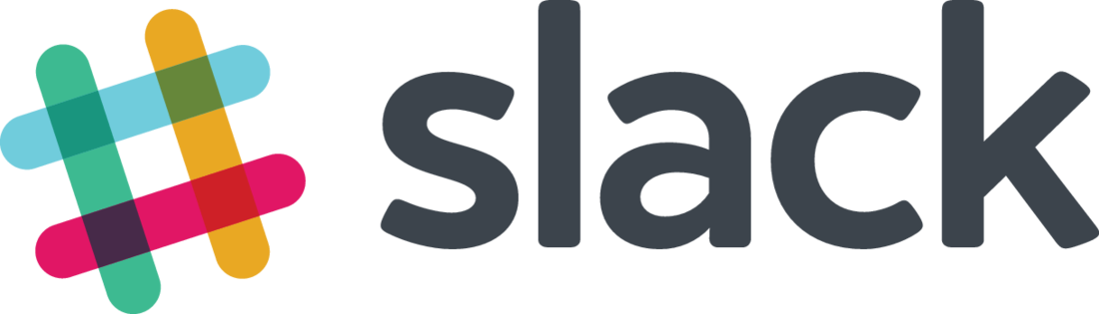
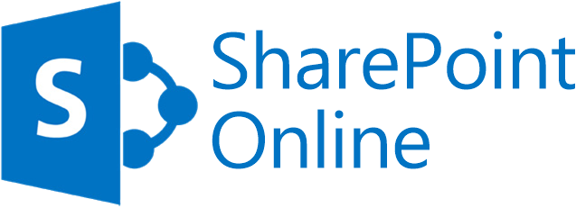

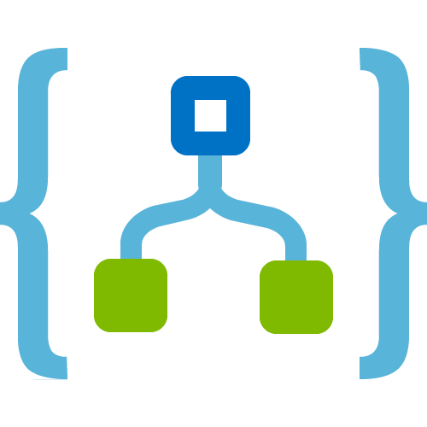




Summary
Azure Functions
Service Bus
Connect on-premises, hybrid and cloud applications
Run mission-critical, complex integration scenarios with ease
Build “Smart” Integrations leveraging Machine Learning/Cognitive Services
Cognitive Services
Logic Apps
Machine Learning
Azure API Management
On-premises data gateway
BizTalk Server

Slide 43



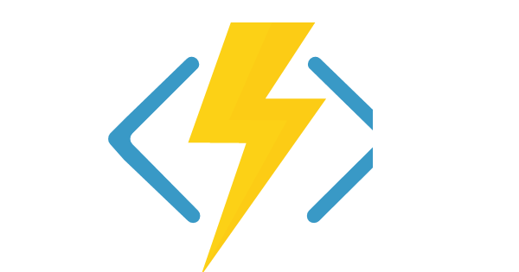
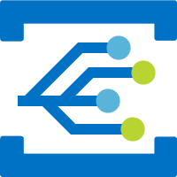
Better Together.
Logic Apps
Service
Bus
Event
Grid
Log
Analytics
BizTalk
Server 2016
API
Management
Data
Factory
Functions
Limitless Possibilities

Slide 44
More info
Microsoft Hybrid Integration Platform​
https://aka.ms/hybrid-integration​
https://aka.ms/infopedia-hip​
Logic Apps Monthly Webcasts​
http://aka.ms/logicappslive
Logic Apps Documentation​
http://aka.ms/logicapps-docs
Logic Apps Blog​
http://aka.ms/logicappsblog ​
Logic Apps Ideas​
http://aka.ms/logicapps-wish
Azure Logic Apps​
http://aka.ms/logicapps-try​
http://aka.ms/logicapps-tutorial​
http://aka.ms/logicappslive​
Twitter​
APIM - @AzureApiMgmt​
BizTalk Server @BizTalk_Server​
Logic Apps - @Logicappsio​
Azure Logic Apps monthly updates (non-MSFT) https://blogs.biztalk360.com/tag/azure-logic-apps/

Slide 45
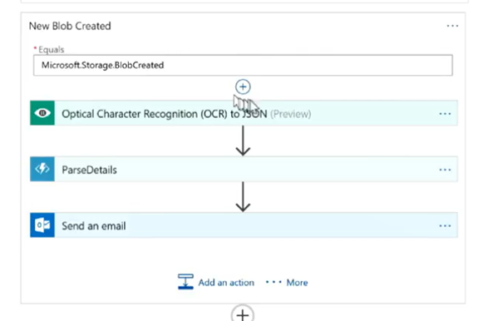
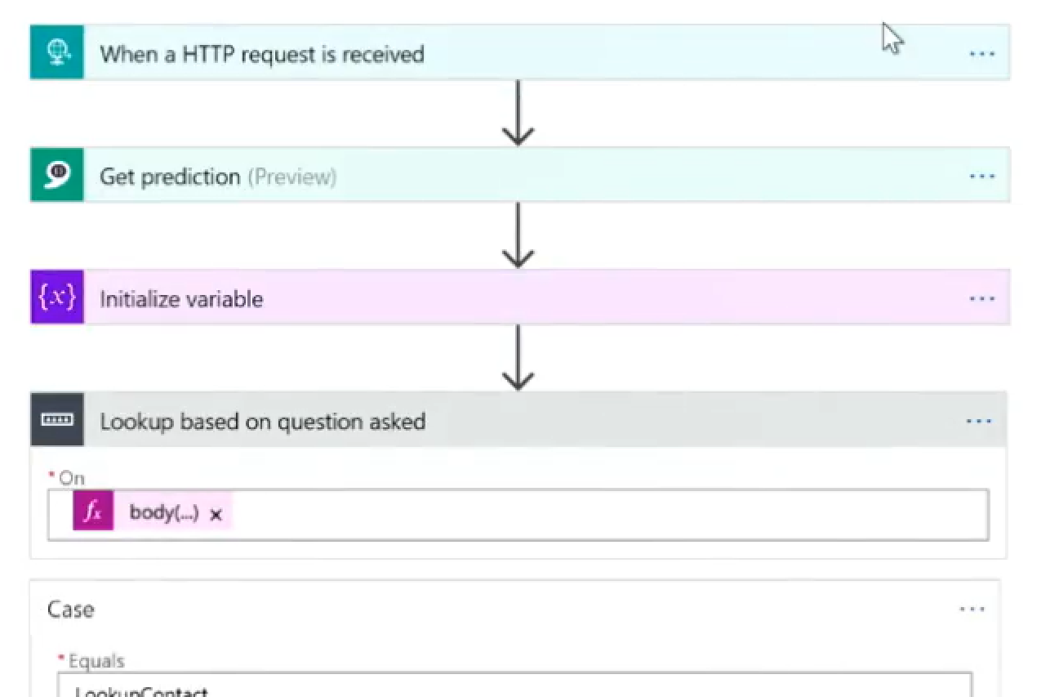
Cool examples
Taking an order from a scanned image (OCR)
Demo: https://youtu.be/uIuHbZWxqQY?t=2244
Bots invoking logic apps that get intent and use connectors to get info by issuing a query to the right backend system (e.g. ‘when did I last hear from this person?’ -> query to dynamics CRM)
Demo: https://youtu.be/uIuHbZWxqQY?t=3602

Slide 46
Thank you!
Questions?

Slide 48
Recommended Practices
10 Tips for enterprise integration with Logic Apps
https://toonvanhoutte.wordpress.com/2017/06/08/10-tips-for-enterprise-integration-with-logic-apps/
Decouple protocol and message processing
Establish reliable messaging
Design for reuse
Secure your Logic Apps
Think about idempotence
Have a clear error handling strategy
Ensure decent monitoring
Use async wherever possible
Don’t forget your integration patterns
Apply application lifecycle management (ALM)
Notes:
10 Tips for enterprise integration with Logic Apps
8 JUNE 2017 / TOONVANHOUTTE
This post was originally published here.
This post contains 10 useful tips for designing enterprise integration solutions on top of Logic Apps. It’s important to think upfront about reusability, reliability, security, error handling and maintenance.
Democratization of integration
Before we dive into the details, I want to provide some reasoning behind this post. With the rise of cloud technology, integration takes a more prominent role than ever before. In Microsoft’s integration vision, democratization of integration is on top of the list.
Microsoft aims to take integration out of its niche market and offers it as an intuitive and easy-to-use service to everyone. The so-called Citizen Integrators are now capable of creating light-weight integrations without the steep learning curve that for example BizTalk Server requires. Such integrations are typically point-to-point, user-centric and have some accepted level of fault tolerance.
As an Integration Expert, you must be aware of this. Enterprise integration faces completely different requirements than light-weight citizen integration: loosely coupling is required, no message loss is accepted because it’s mission critical interfacing, integrations must be optimized for operations personnel (monitoring and error handling), etc…
Keep this in mind when designing Logic App solutions for enterprise integration! Make sure you know your cloud and integration patterns. Ensure you understand the strengths and limits of Logic Apps. The advice below can give you a jump start in designing reliable interfaces within Logic Apps!
Design enterprise integration solutions
1. Decouple protocol and message processing
Once you created a Logic App that receives a message via a specific transport protocol, it’s extremely difficult to change the protocol afterwards. This is because the subsequent actions of your Logic App often have a hard dependency on your protocol trigger / action. The advice is to perform the protocol handling in one Logic App and hand over the message to another Logic App to perform the message processing. This decoupling will allow you to change the receiving transport protocol in a flexible way, in case the requirements change or in case a certain protocol (e.g. SFTP) is not available in your DEV / TEST environment.
2. Establish reliable messaging
You must realize that every action you execute, is performed by an underlying HTTP connection. By its nature, an HTTP request/response is not reliable: the service is not aware if the client disconnects during request processing. That’s why receiving messages must always happen in two phases: first you mark the data as returned by the service; second you label the data as received by the client (in our case the Logic App). The Service Bus Peek-Lock pattern is a great example that provides such at-least-once reliability. Another example can be found here.
3. Design for reuse
Real enterprise integration is composed of several common integration tasks such as: receive, decode, transform, debatch, batch, enrich, send, etc… In many cases, each task is performed by a combination of several Logic App actions. To avoid reconfiguring these tasks over and over again, you need to design the solution upfront to encourage reuse of these common integration tasks. You can for example use the Process Manager pattern that orchestrates the message processing by reusing nested Logic Apps or introduce the Routing Slip pattern to build integration on top of generic Logic Apps. Reuse can also be achieved on the deployment side, by having some kind of templated deployments of reusable integration tasks.
4. Secure your Logic Apps
From a security perspective, you need to take into account both role-based access control to your Logic App resources and runtime security considerations. RBAC can be configured in the Access Control (IAM) tab of your Logic App or on a Resource Group level. The runtime security really depends on the triggers and actions you’re using. As an example: Request endpoints are secured via a Shared Access Signature that must be part of the URL, IP restrictions can be applied. Azure API Management is the way to go if you want to govern API security centrally, on a larger scale. It’s a good practice to assign the minimum required privileges (e.g. read only) to your Logic Apps.
5. Think about idempotence
Logic Apps can be considered as composite services, built on top of several API’s. API’s leverage the HTTP protocol, which can cause data consistency issues due to its nature. As described in this blog, there are multiple ways the client and server can get misaligned about the processing state. In such situations, clients will mostly retry automatically, which could result in the same data being processed twice at server side. Idempotent service endpoints are required in such scenarios, to avoid duplicate data entries. Logic Apps connectors that provide Upsert functionality are very helpful in these cases.
6. Have a clear error handling strategy
With the rise of cloud technology, exception and error handling become even more important. You need to cope with failure when connecting to multiple on premise systems and cloud services. With Logic Apps, retry policies are your first resort to build resilient integrations. You can configure a retry count and interval at every action, there’s no support for exponential retries or circuit breaker pattern. In case the retry policy doesn’t solve the issue, it’s advised to return a clear error description within sync integrations and to ensure a resumable workflow within async integrations. Read here how you can design a good resume / resubmit strategy.
7. Ensure decent monitoring
Every IT solution benefits from a good monitoring. It provides visibility and improves the operational experience for your support personnel. If you want to expose business properties within your monitoring, you can use Logic Apps custom outputs or tracked properties. These can be consumed via the Logic Apps Workflow Management API or via OMS Log Analytics. From an operational perspective, it’s important to be aware that there is an out-of-the-box alerting mechanism that can send emails or trigger Logic Apps in case a run fails. Unfortunately, Logic Apps has no built-in support for Application Insights, but you can leverage extensibility (custom API App or Azure Function) to achieve this. If your integration spans multiple Logic Apps, you must foresee correlation in your monitoring / tracing! Find here more details about monitoring in Logic Apps.
8. Use async wherever possible
Solid integrations are often characterized by asynchronous messaging. Unless the business requirements really demand request/response patterns, try to implement them asynchronously. It comes with the advantage that you introduce real decoupling, both from a design and runtime perspective. Introducing a queuing system (e.g. Azure Service Bus) in fire-and-forget integrations, results in highly scalable solutions that can handle an enormous amount of messages. Retry policies in Logic Apps must have different settings depending whether you’re dealing with async or sync integration. Read more about it here.
9. Don’t forget your integration patterns
Whereas BizTalk Server forces you to design and develop in specific integration patterns, Logic Apps is more intuitive and easier to use. This could come with a potential downside that you forget about integration patterns, because they are not suggested by the service itself. As an integration expert, it’s your duty to determine which integration patterns should be applied on your interfaces. Loosely coupling is common for enterprise integration. You can for example introduce Azure Service Bus that provides a Publish/Subscribe architecture. Its message size limitation can be worked around by leveraging the Claim Check pattern, with Azure Blob Storage. This is just one example of introducing enterprise integration patterns.
10. Apply application lifecycle management (ALM)
The move to a PaaS architecture, should be done carefully and must be governed well, as described here. Developers should not have full access to the production resources within the Azure portal, because the change of one small setting can have an enormous impact. Therefore, it’s very important to setup ALM, to deploy your Logic App solutions throughout the DTAP-street. This ensures uniformity and avoids human deployment errors. Check this video to get a head start on continuous integration for Logic Apps and read this blog on how to use Azure Key Vault to retrieve passwords within ARM deployments. Consider ALM as an important aspect within your disaster recovery strategy!
Conclusion
Yes, we can! Logic Apps really is a fit for enterprise integration, if you know what you’re doing! Make sure you know your cloud and integration patterns. Ensure you understand the strengths and limits of Logic Apps. The Logic App framework is a truly amazing and stable platform that brings a whole range of new opportunities to organizations. The way you use it, should be depending on the type of integration you are facing!

Slide 49
NDA
What’s Coming
Dedicated
Enterprise
Connectors
Mock Testing
Disaster Recovery
Smart Designer
Retention Lifetime
Draft Slots
RPA??
Sovereign
Regions
Notes:
Concurrency control
Request trigger OAuth
Draft slot
Run action
Mock Testing
Resubmit from failed action
XSLT with assemblies
JSON message handling
OMS download
Snippets
Condition builder
Configurable logic app lifetime
Connectors
Azure Container Service
Marketo
Lithium
Office 365 Excel
Oracle EBS
SAP Trigger
Workday Finance
On-premises custom connectors
OPDG High Availability

Slide 50





Public References
 | Global luxury brand Use Logic Apps to automate their accounts payable integration and workflow Improve time to approve invoices, gain agility and speed up processing
 | Premier outdoor pursuits, clothing manufacturer and retailer Using Logic Apps for their messaging backbone and distribution Using hybrid integration to back-office systems on premises via Logic App-orchestrated processes
 | New Zealand-based electrical contractor and power distribution company Needed an out of band, sure-fire method to process client service requests - especially during major storm events when service outages often occur Use Logic Apps to quickly automate reliable processing to communicate with engineers and schedule and dispatch work requests by communicating with their existing line of business systems
 | Reverse logistics company for healthcare industry Use Logic Apps EDI to track drug returns to manufacturers and distributors for safe and reliable disposal Logic Apps connects Qualanex to their customers systems and their trading partners to automate returns
 | Microsoft IT runs Microsoft’s backoffice line of business systems and critical applications portfolio Our marketing systems connect to over 120 data sources Data integration become significantly easier with Logic Apps, reducing costs, time and providing more flexibility to change procesess quickly and easily
Click for Full list

Slide 51
Logic Apps in a nutshell
Getting started: https://docs.microsoft.com/en-us/azure/logic-apps/ and https://youtu.be/Ic4tS46lV4A
Hyperscale workflow engine for mission critical enterprise integration of services across Azure, third party SaaS services and on-premises and available in Azure as a Serverless platform
Logic Apps is a job scheduler with a JSON-based DSL (https://docs.microsoft.com/en-us/azure/logic-apps/logic-apps-workflow-definition-language) describing a dependency graph of actions and a highly parallelized concurrent job execution engine
Over 200 out of box connectors and rich set of starter templates
New support for custom connectors
Triggers: polling, webhook, recurrence, events via event grid
Designer options: Hosted (web) based designer in Azure Management Portal or Visual Studio plug-in 2015 or 2017
Source control and CI/CD pipeline support
ARM deployment templates, parameter auto-parameterization
Promotion using web designer (cross environment deployment, e.g. dev -> test -> prod)
Monitoring and Diagnostics support*
Integration account: XML Schemas and XSLT Maps, Trading Partners, Agreements, Certificates, AS2/X12/EDIFACT support
Notes:
https://myignite.microsoft.com/sessions/54873?source=sessions (https://youtu.be/Ic4tS46lV4A)
Built-in actions, for example, actions that call HTTP, Azure Functions, or API Management, as well as control flow steps, are metered as native actions and have their respective types. Actions that call connectors have the "ApiConnection" type. Connectors are classified as either standard or enterprise connectors, and are metered at their respective pricing.
Custom connectors – not just ability to call any API or create custom connectors in code, but now no-code ability to create custom connectors from the portal
Visual Studio plug-in 2015 or 2017
From cloud explorer:
Browse and search
Edit in designer & publish changes
Enable, disable, delete
Run and view run history
Download logic app (ARM template)
= will be discussed in more details later in this session
Integration account connectors are for more specialized tasks, for example, for working with XML or business-to-business message exchange, for example, X12, EDIFACT, and encoding and decoding flat files. If you've used this tool before, many of the things that you would typically do with an on-premises BizTalk server can also be done here with integration account connectors.
It is also a good fit for when you want to connect an on-premises BizTalk server with Azure Logic apps in the cloud. The next level is enterprise connectors. Enterprise connectors are for connecting to very specific, enterprise-based services, things like SAP, things like MQSeries, and so forth. Both integration account connectors and enterprise connectors come at an additional cost.
If you’re dealing with customers who have BizTalk, integration account is a “must-know”

Slide 52
Main Microsoft workflow technologies
Logic Apps / Microsoft Flow
Durable Functions
Windows Workflow Foundation (WWF) / Workflow Manager / Sharepoint Workflow
Biztalk Server
Azure Data Factory (ADF)
Limited to movement and transformation of data, aka data-driven workflow
https://docs.microsoft.com/en-us/azure/data-factory/introduction
Windows Powershell Workflow
https://technet.microsoft.com/en-us/library/jj134242(v=ws.11).aspx
Notes:
The focus of this presentation is on Logic Apps.
Microsoft Flow is based on logic apps and we’ll discuss when to use which.
We won’t compare and contrast logic apps with durable functions, and briefly touch on the future of the Biztalk server.

Slide 53
Messaging Patterns 2 of 3
Competing consumer
https://blogs.msdn.microsoft.com/vinaysin/2017/04/14/logic-apps-performance-with-service-bus/
Notes:
Competing consumer: a way to scale logic apps -- https://blogs.msdn.microsoft.com/vinaysin/2017/04/14/logic-apps-performance-with-service-bus/
Data enricher – during the workflow execution, certain actions get additional info from other systems and add/enrich the message that’s passed on down the way
Content based router – process broker (from prev. slide)
In order processing:
- Use transport that provides ordered delivery, e.g. Service Bus queues
- Use Singleton workflows (use singleton option in trigger)
- Remove parallelism from foreach (use sequential option in foreach)
Correlation – e.g. response queue or URI passed along, session queue in Service Broker, convoy pattern
Note: Sequential Convoy (related messages go to a single instance, e.g. hospital patient encounter – workflow instance per patient per encounter/case). Use Service Bus Sessions (requires sessions to be enabled on queue/topic, trigger with next available session, get next message using initiating session id)

Slide 54
Messaging Patterns 3 of 3
Data Enricher
Content based Router
In order processing
https://blogs.msdn.microsoft.com/logicapps/2017/05/02/in-order-delivery-of-correlated-messages-in-logic-apps-by-using-service-bus-sessions/
Correlation of workflows
Sequential convoy implemented in “Correlated in-order delivery using Service Bus sessions” template
Pseudo-code::
Initialize SessionId = NextAvailable
Loop
PeekAndLockMessage(sessionId)
SendMessageToTopic(sessionId + “-topic”)
sessionId = message.SessionId
CompleteMessage
Until (…)
Notes:
Request/Reply: if you have a request end point, you may have a reply at the end of your workflow (synchronous), but you may also have it earlier in the process acknowledging receiving the request and continuing with asynchronous processing
Splitter – on trigger, can have a SplitOn property. Used if your workflow receives a collection or batch of items to process. You can choose a property that is used to create a new instance of the workflow to parallelize the work with multiple workflow instances processing the request, i.e. spliton property.
Pub-Sub – using Service Bus topics
Claim-check – e.g. service bus has a limit on message size. If you want to pass big workloads around, put that data into a blob and use a reference to it (URI) as data in your message.
Batch – grouping desperate messages for processing. This is very useful in cases where it’s important not to overwhelm a downstream system by numerous individual requests
Note: batch release criteria can be composed, e.g. process whatever we have every hour regardless of number of messages, or every 100 messages…
Competing consumer: a way to scale logic apps -- https://blogs.msdn.microsoft.com/vinaysin/2017/04/14/logic-apps-performance-with-service-bus/
Data enricher – during the workflow execution, certain actions get additional info from other systems and add/enrich the message that’s passed on down the way
Content based router – process broker (from prev. slide)
In order processing:
- Use transport that provides ordered delivery, e.g. Service Bus queues
- Use Singleton workflows (use singleton option in trigger)
- Remove parallelism from foreach (use sequential option in foreach)
Correlation – e.g. response queue or URI passed along, session queue in Service Broker, convoy pattern
Note: Sequential Convoy (related messages go to a single instance, e.g. hospital patient encounter – workflow instance per patient per encounter/case). Use Service Bus Sessions (requires sessions to be enabled on queue/topic, trigger with next available session, get next message using initiating session id)

Slide 55
Advanced Scenarios
Distributed processing
Ability to span multiple scale units for a single logic app definition
Concurrency control
http://mlogdberg.com/logicapps/concurrency-control
Chunked messaging (up to 1 Gb messages)
{ “runtimeConfiguration”: {
"operationOptions" : "OptimizedForHighThroughput“ },
. . . }
{ “runtimeConfiguration”: {
“concurrency" : { “runs”: 5 }},
. . . }
Notes:
So why these limitations on services?
These are that for preserving the SLAs that our services define in their service definitions.
Passive trigger = time / polling
Active trigger = event driven
Disaster recovery
Logic apps with passive triggers can be created in an alternative region but routing is manual (e.g. using API management)
Logica apps with active triggers can be created in an alternative region but would need custom work to enable / disable the apps as needed.

Slide 56
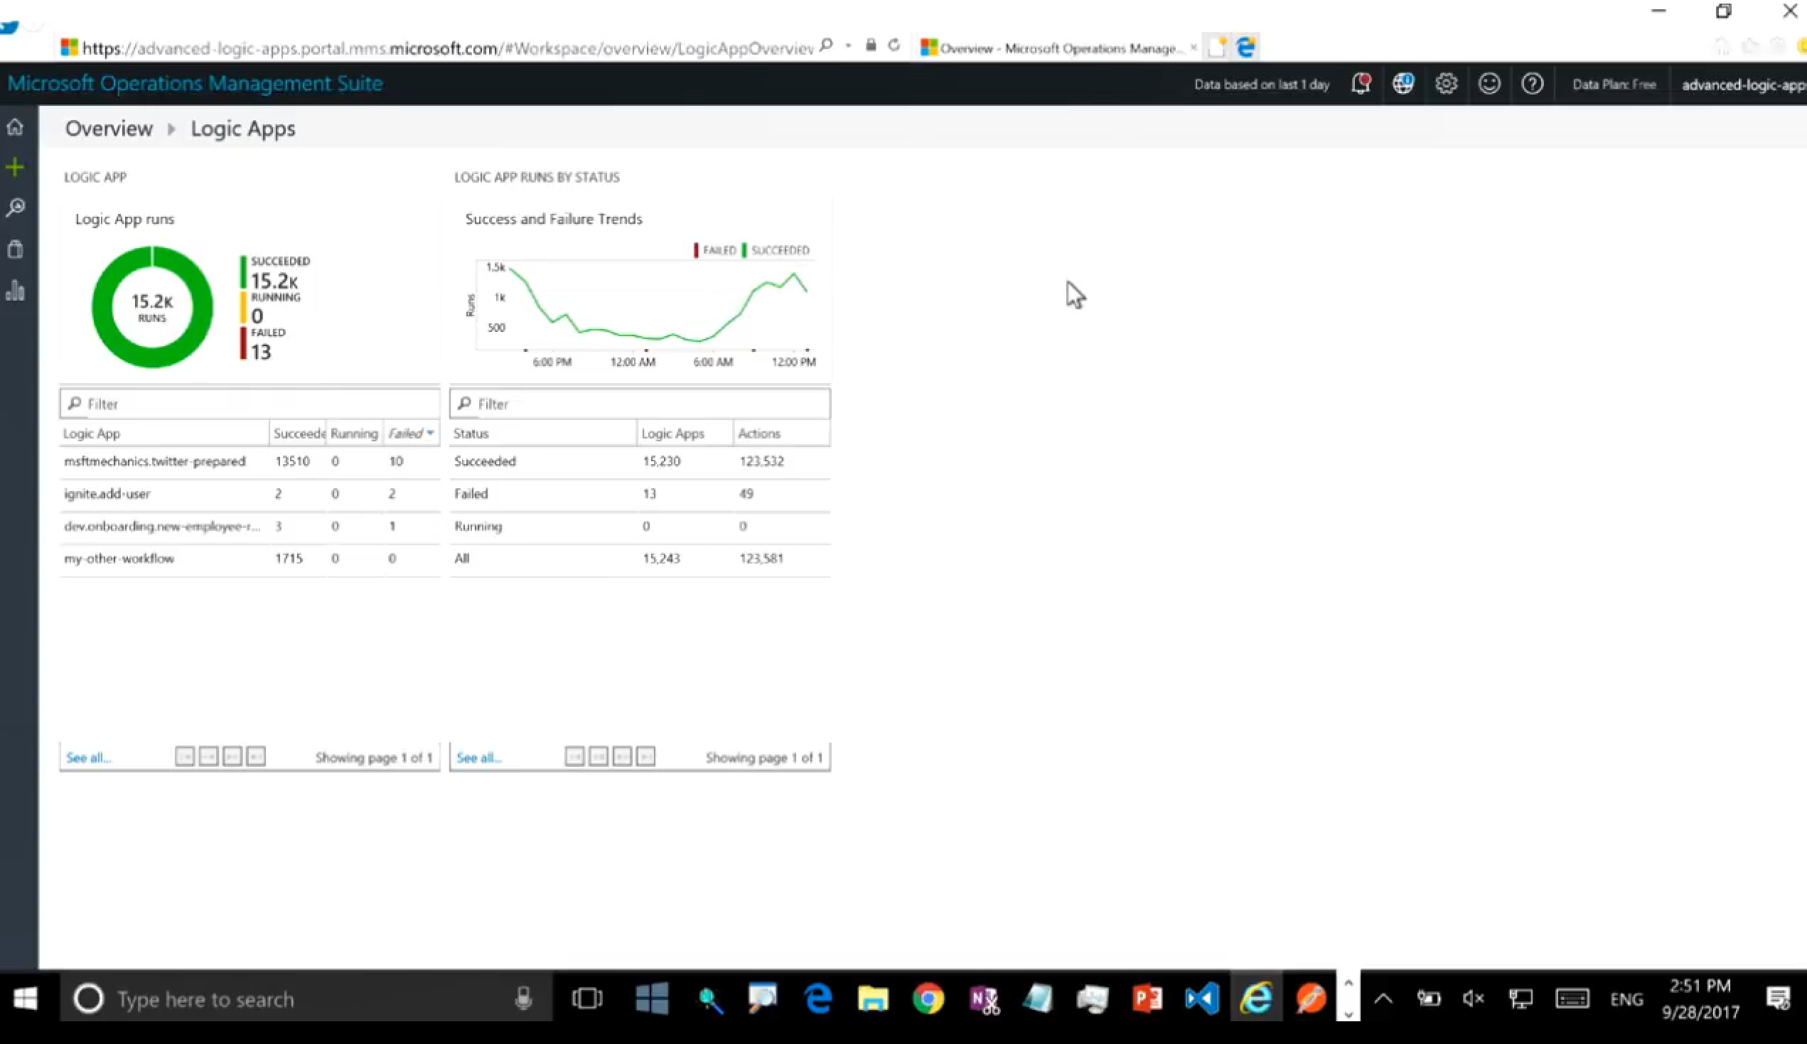
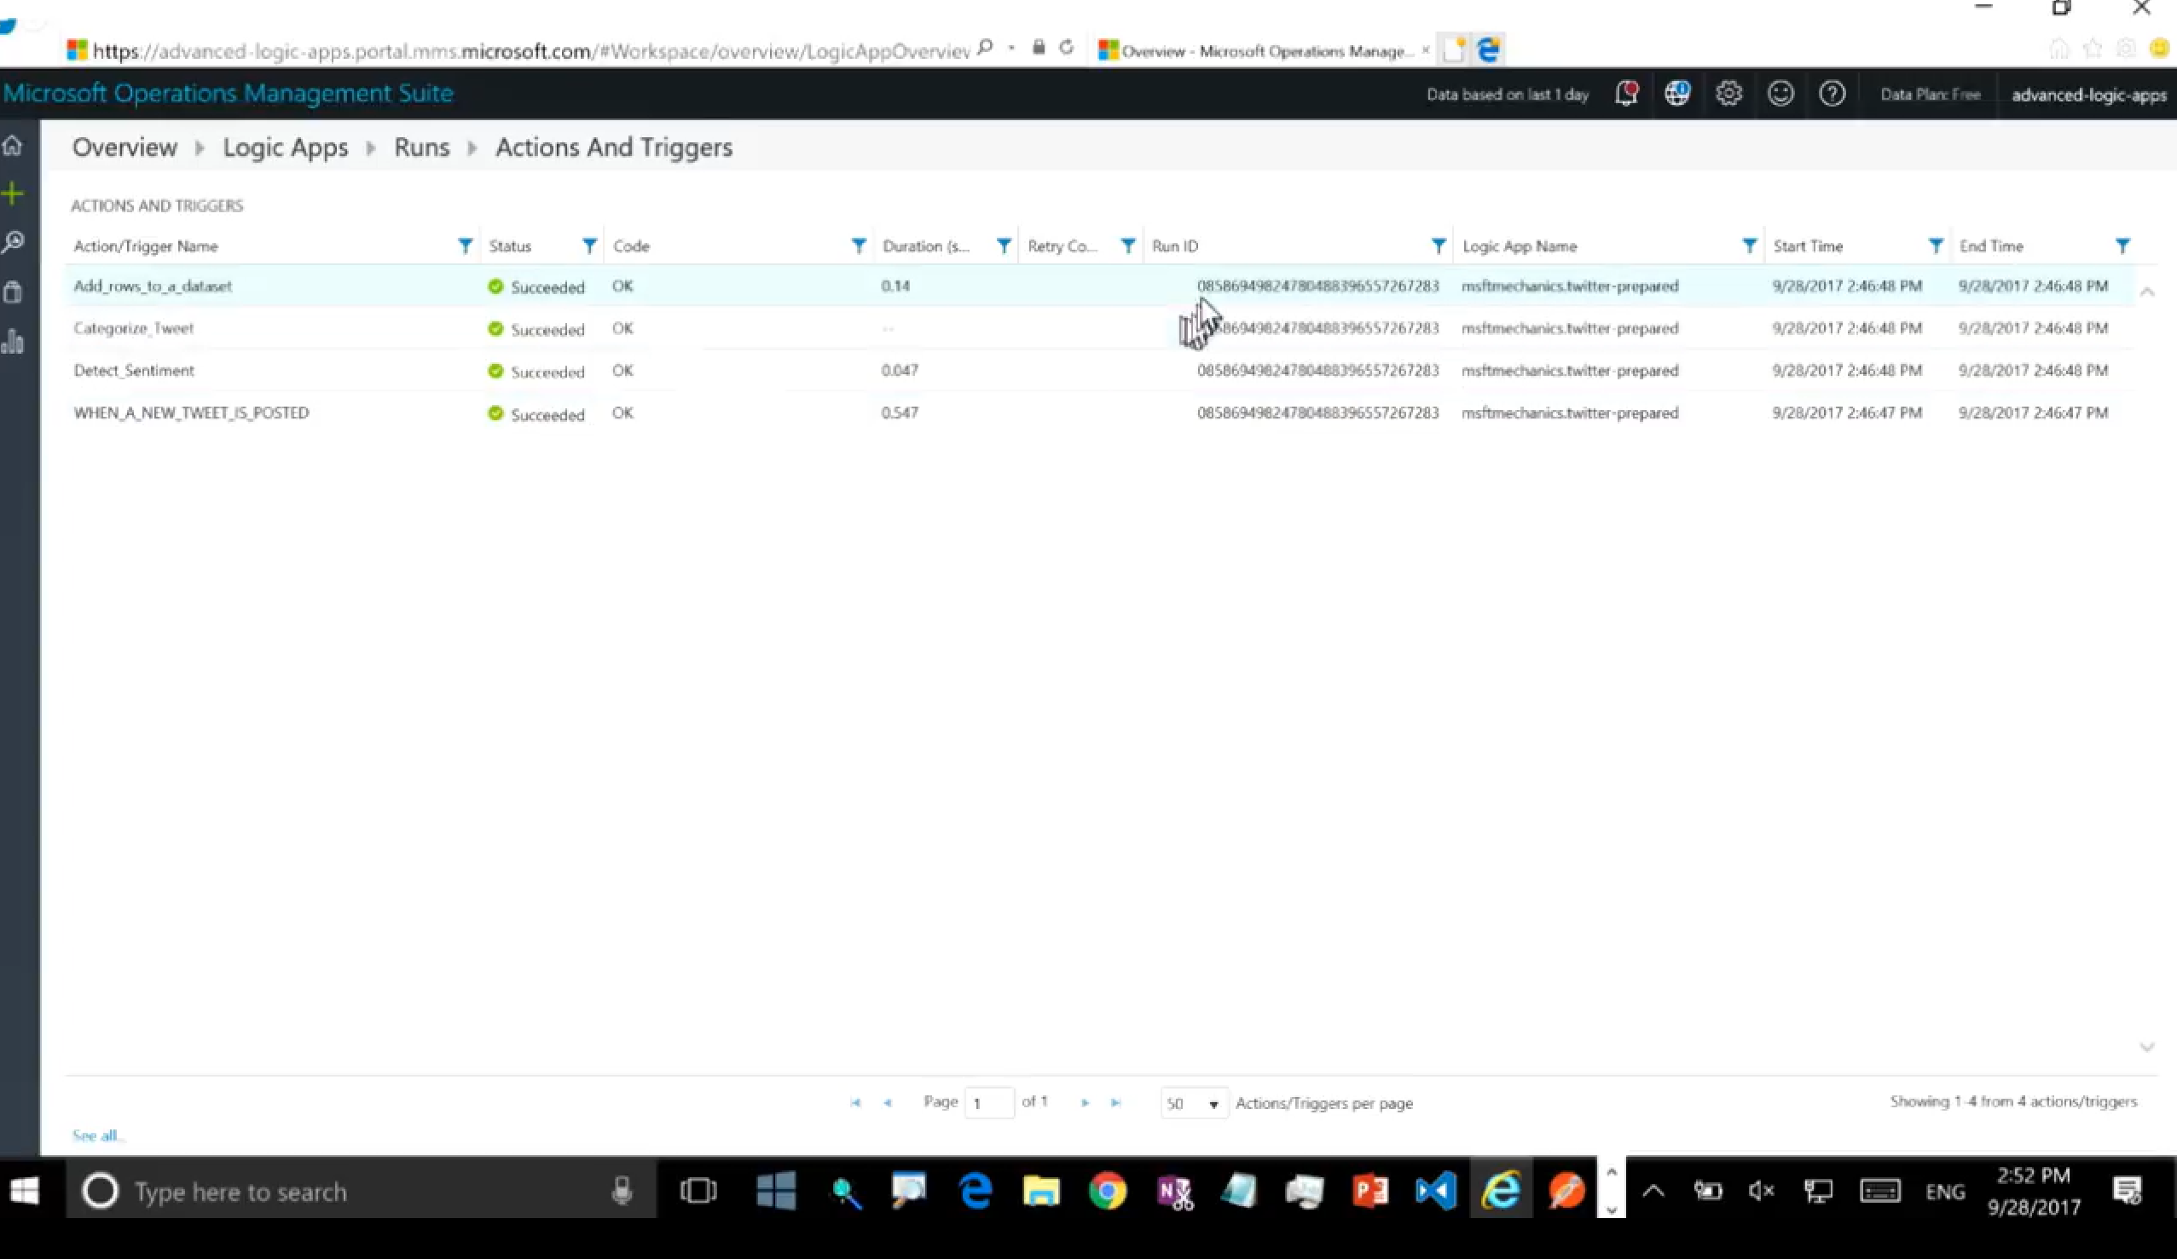
Tracked properties and tracking API
Notes:
Tracked properties – logic app is going to log some standard properties such as when an action started and completed, the result, etc.
You can also have your own properties added to the log to provide more business context, e.g. order id that’ll help you find failed instances based on business data. You can then query on those tracked properties in log analytics.
Tracking API – in addition to being able to track certain properties, you can call a RESTful API and write tracking events to logic app diagnostic logs.
OMS sits on top of log analytics

